Slide 1
Reproducing results in
Probing the solar coronal magnetic field with physics-informed neural networks (Jarolim et al. 2022, preprint)
using
Neural Network Force-Free magnetic field extrapolation - NF2
(https://github.com/RobertJaro/NF2)
Mingyu Jeon

Slide 2
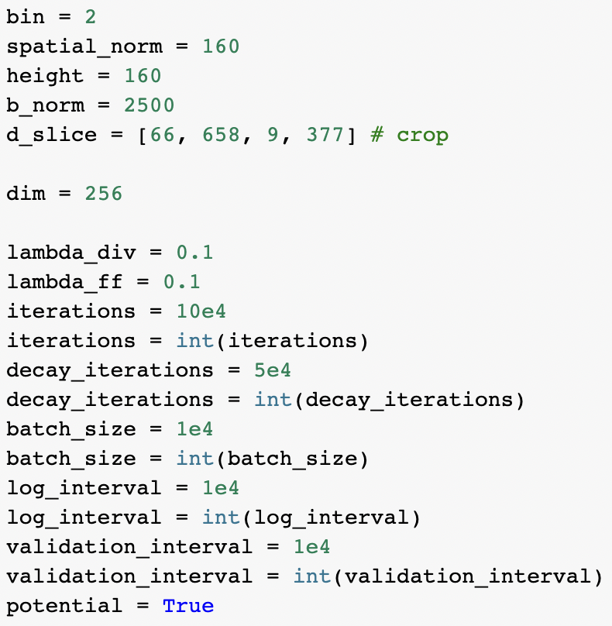
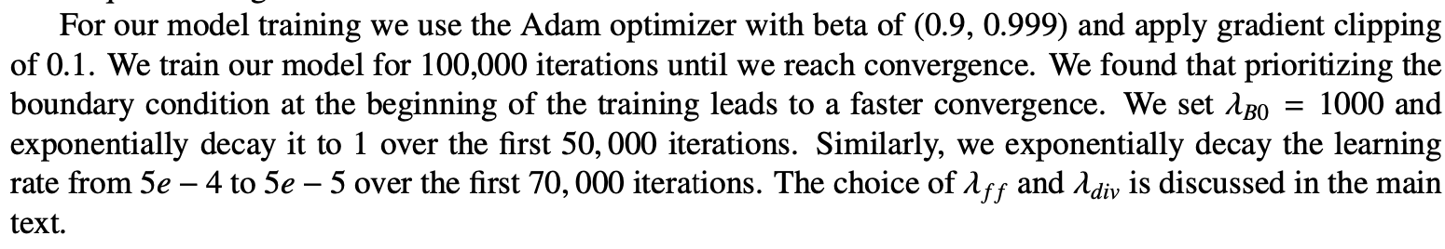
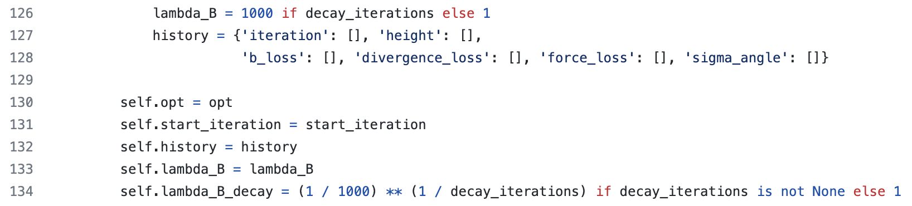
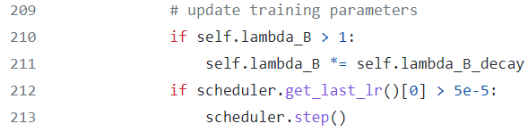
Methods
use 100,000 iterations
instead of 70,000 iterations
= 100,000
Probably it is the reason my result's energy is higher than others
because only this parameter is different from the preprint.
https://github.com/RobertJaro/NF2/blob/main/nf2/train/trainer.py

Slide 3
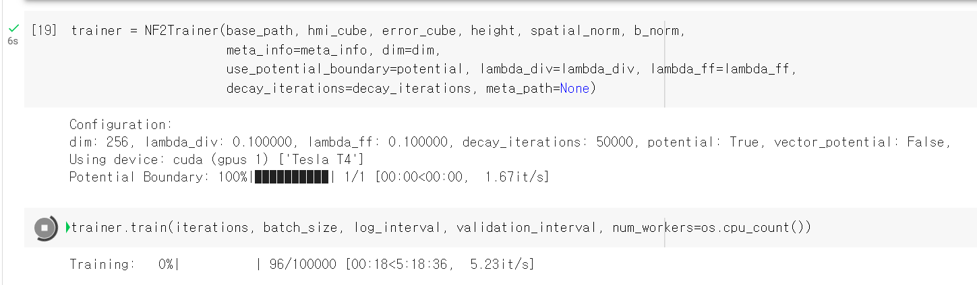
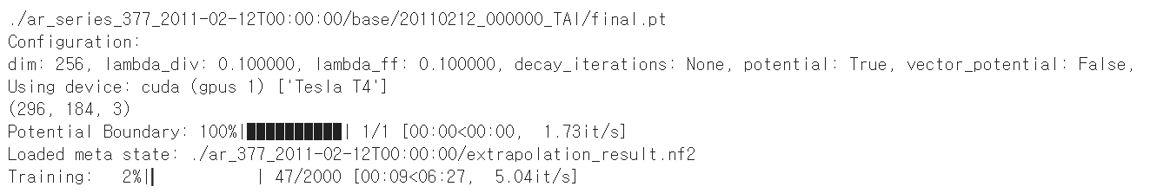
Methods
Preprint
Colab (usually)
https://browser.geekbench.com/opencl-benchmarks
~ x2.3 => 2h * 2.3 ~ 4.6h
Initial training ~ 5.5h
Series training ~ 6.5min per extrapolation
Total ~ 600*6.5min ~ 65h

Slide 4
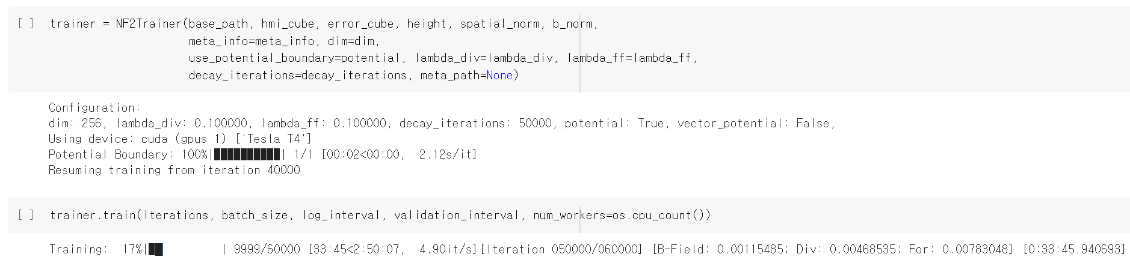
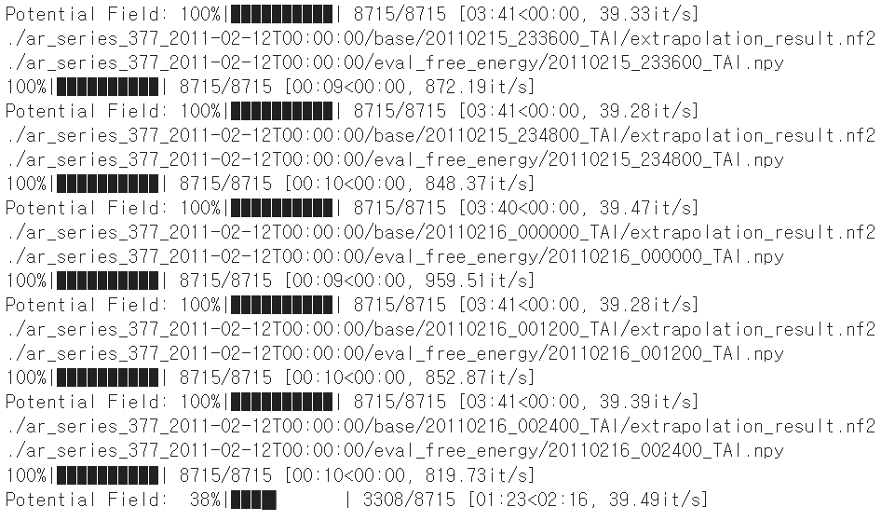
Methods
Resuming initial training using checkpoint.pt for Colab
Free energy ~ 3.5min
Total ~ 600*3.5min ~ 35h

Slide 5
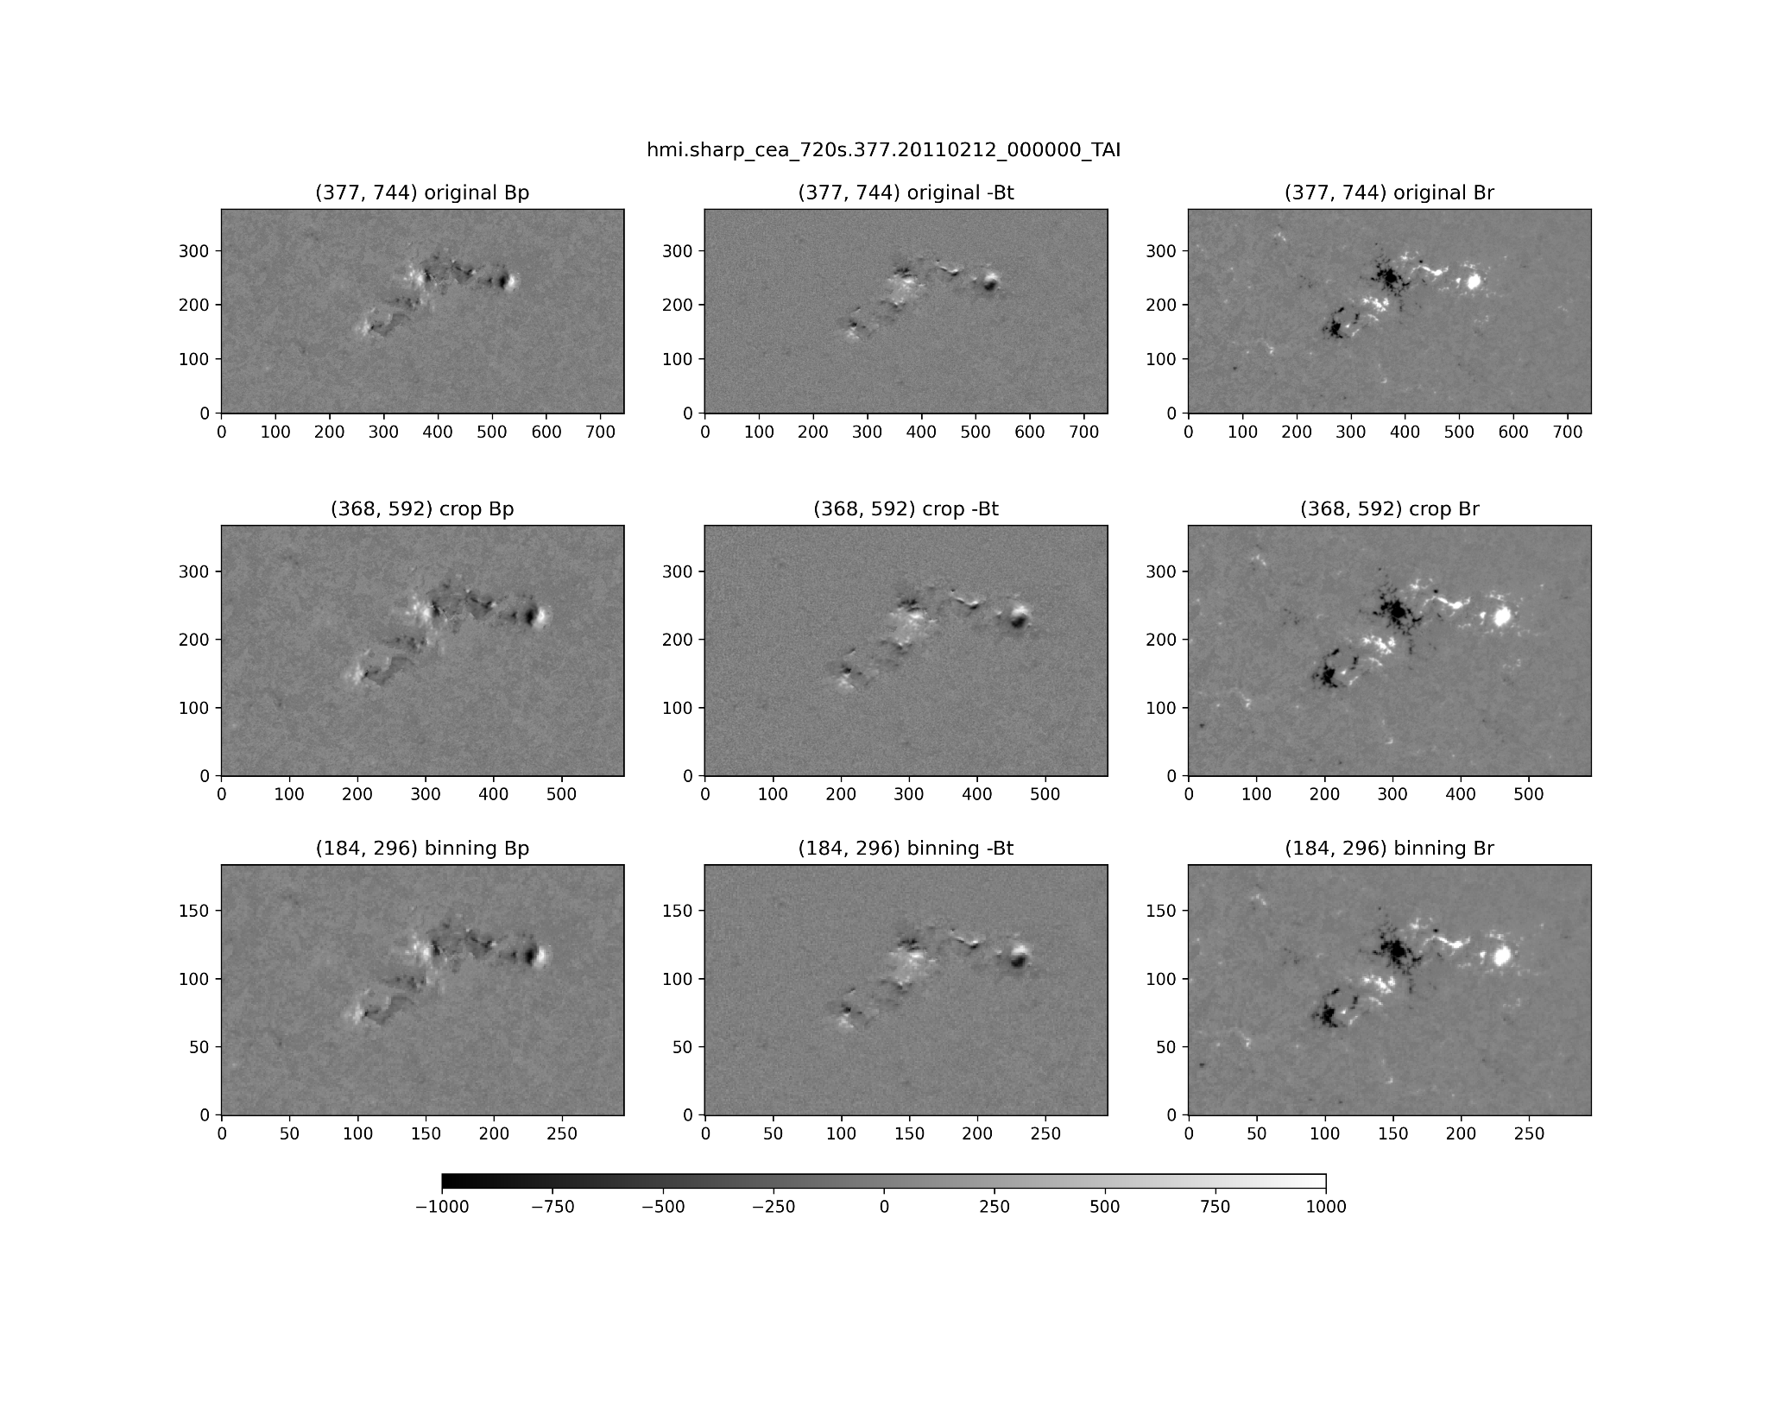
NOAA 11158
2011-02-12 00:00:00
crop
binning (bin=2)

Slide 6
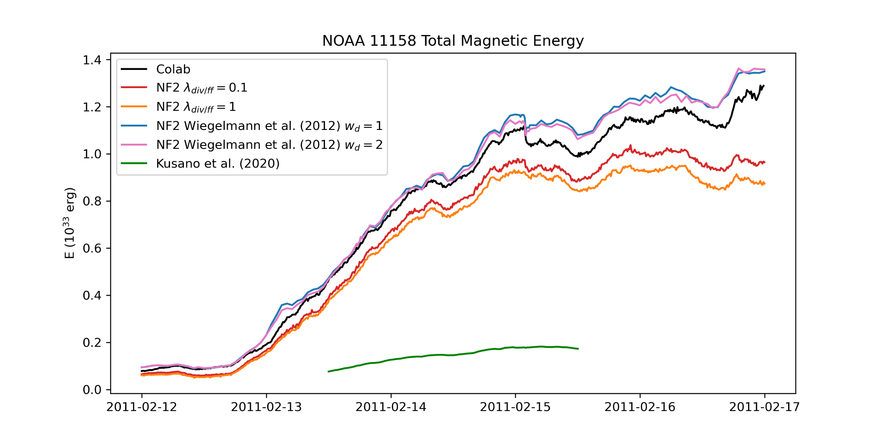
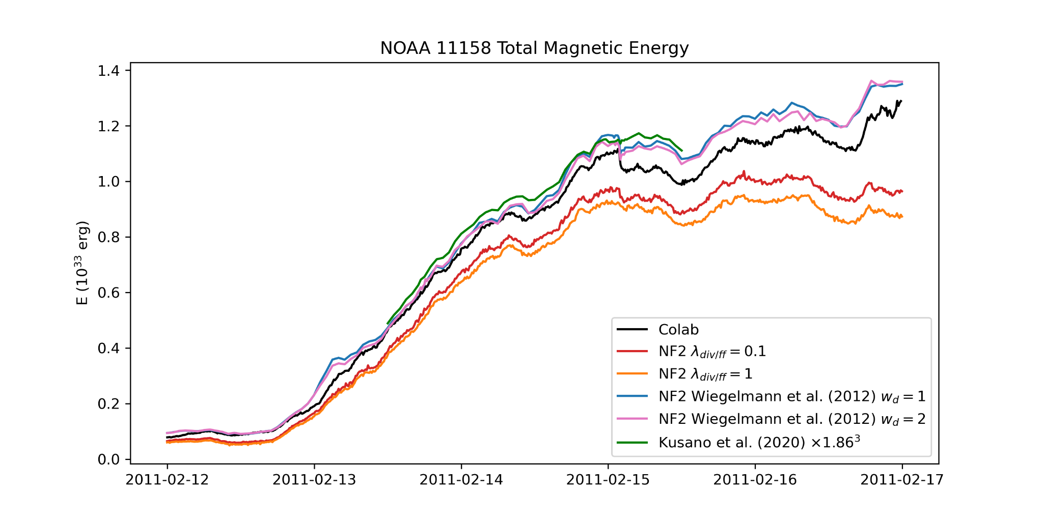
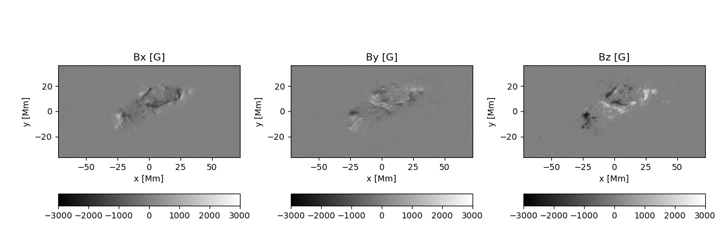
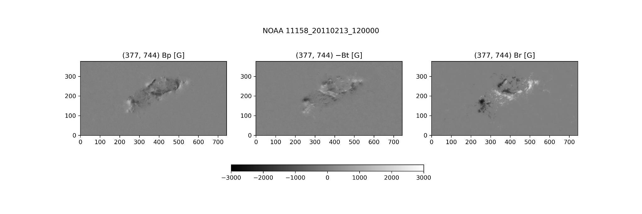
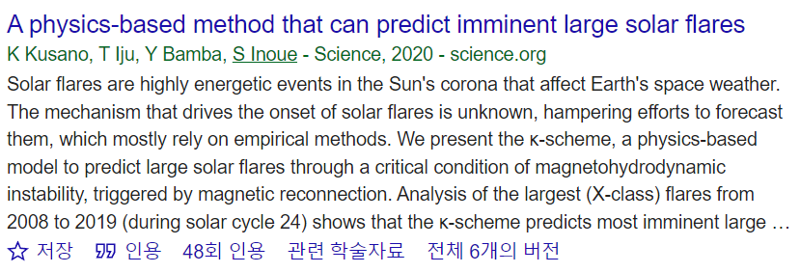
NOAA 11158
Colab → dV = (360e5 * 2)**3
NF2 → data from csv files provided by authors
https://kanzelhohe.uni-graz.at/nf2/
Kusano et al. 2020 → dV = dx*dy*dz
https://hinode.isee.nagoya-u.ac.jp/nlfff_database/
SHARP Xsize = 744 pixel * 0.36 Mm/pixel ~ 268 Mm
Kusano Xsize ~ 144 Mm
SHARP Ysize = 377 pixel * 0.36 Mm/pixel ~ 136 Mm
Kusano Ysize ~ 73 Mm
=> bin ~ 1.86

Slide 7
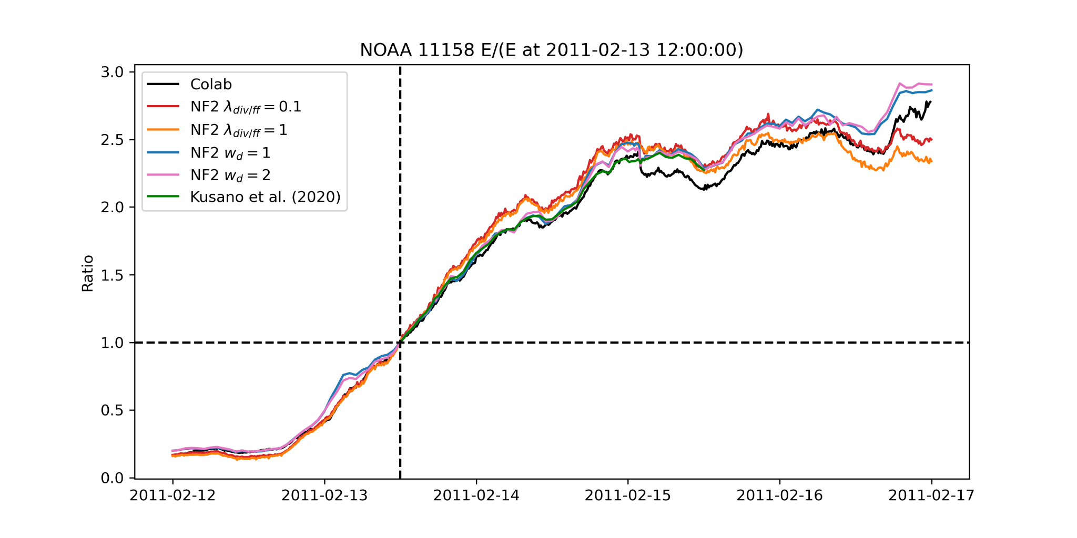
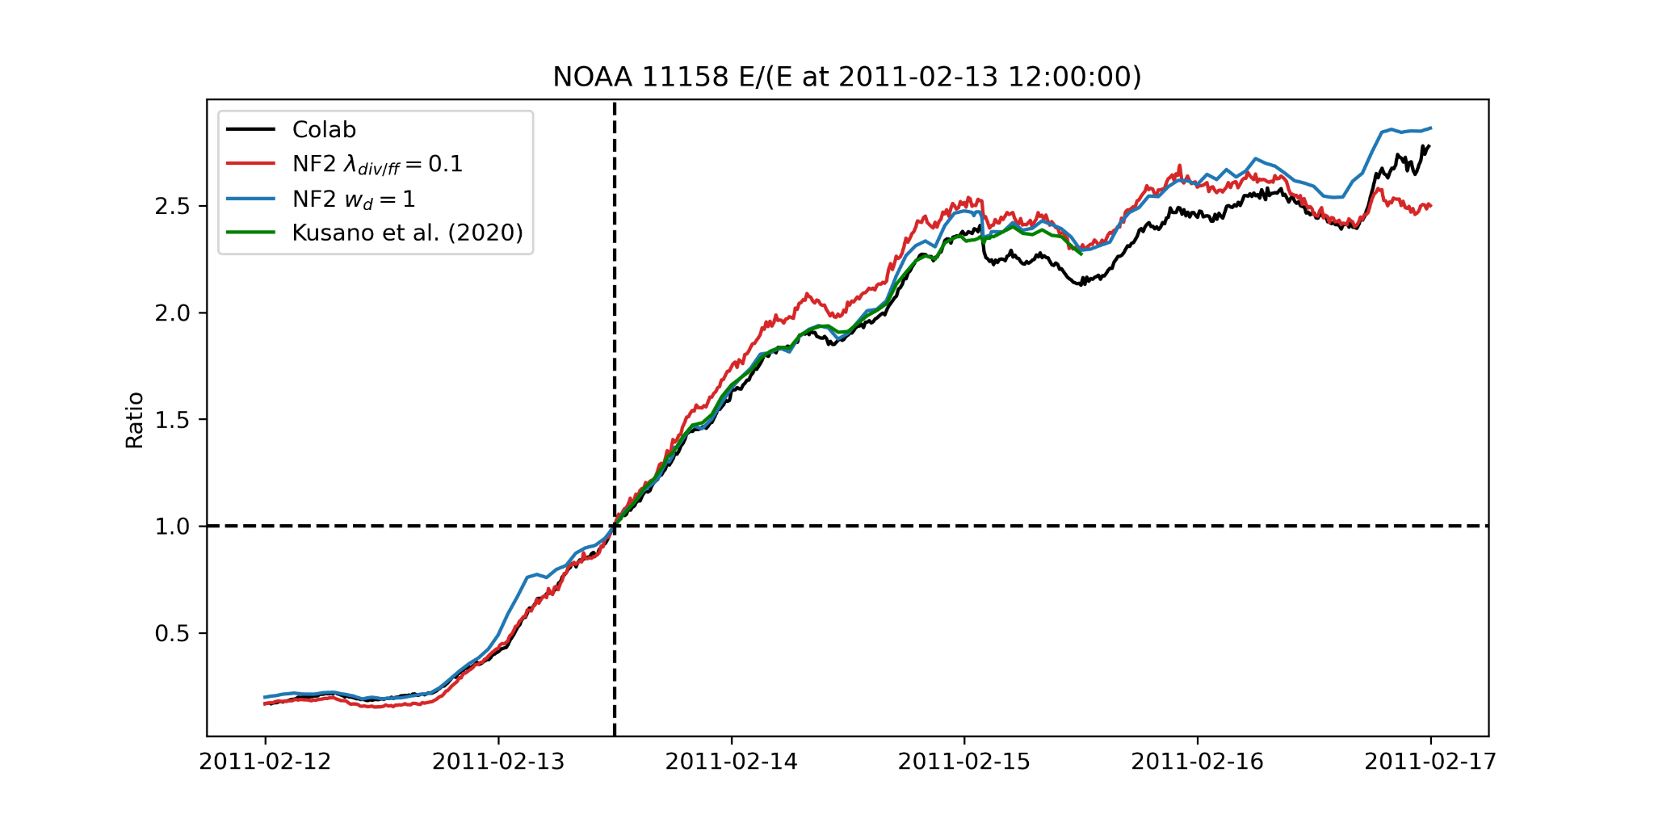
NOAA 11158
Ratio = energy / (energy at 2011-02-13 12:00:00)
2011-02-13 12:00:00 = the first time in Kusano's data

Slide 8
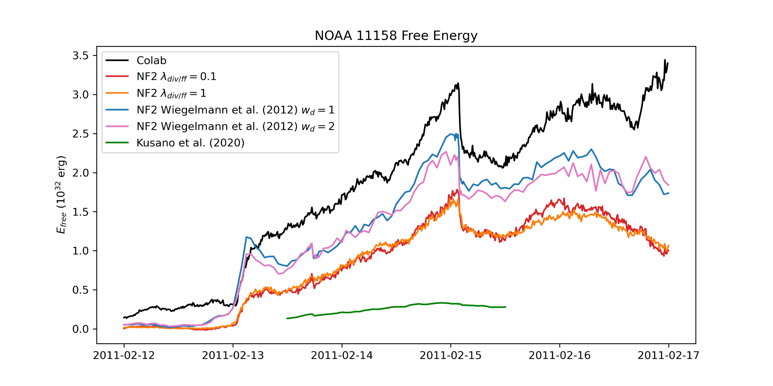
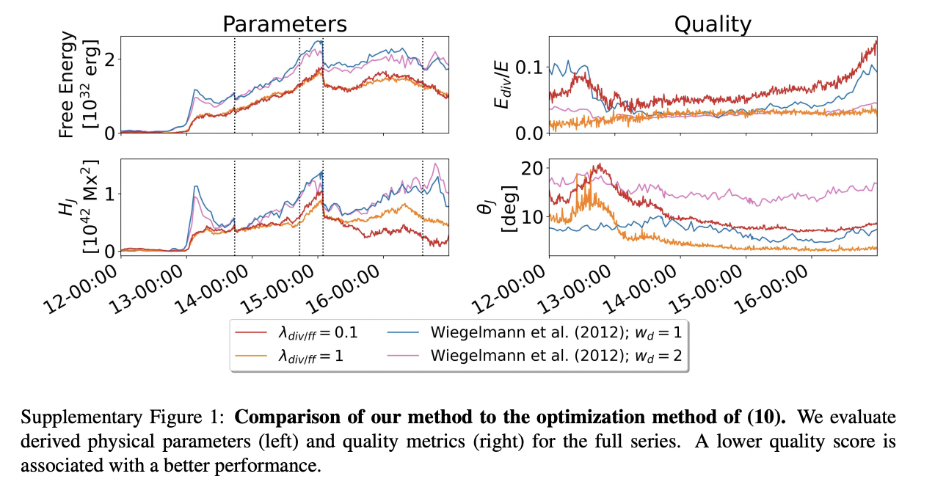
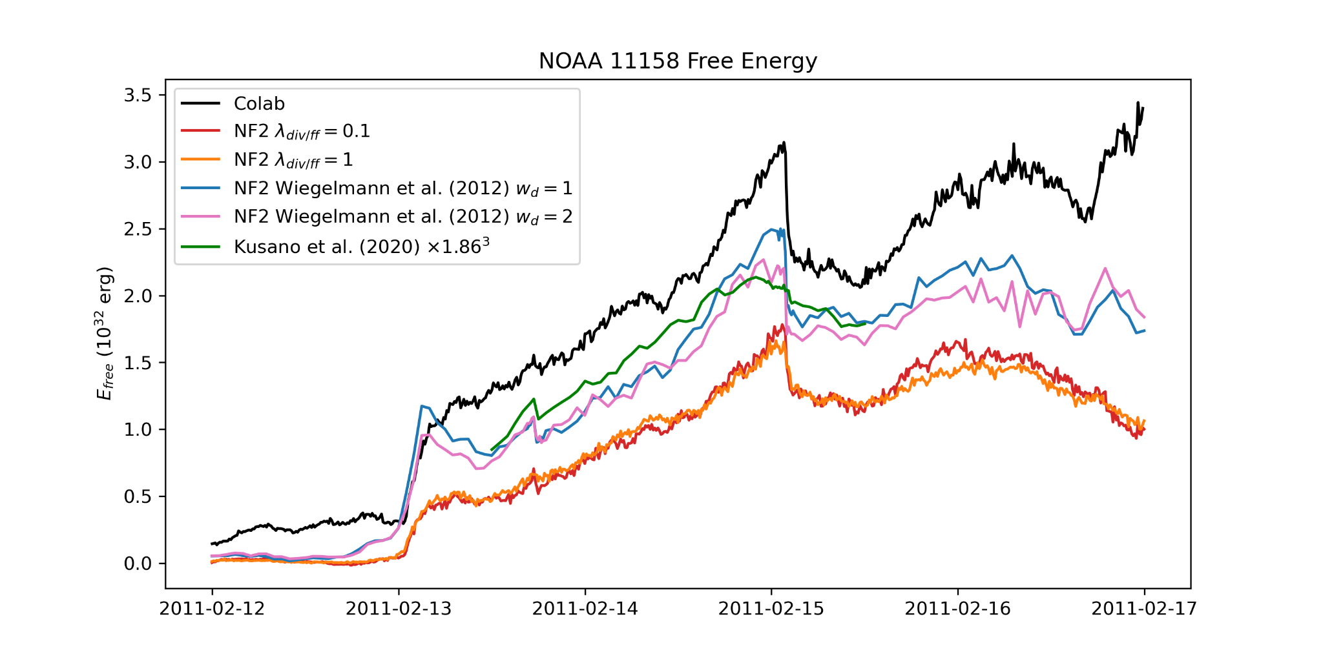
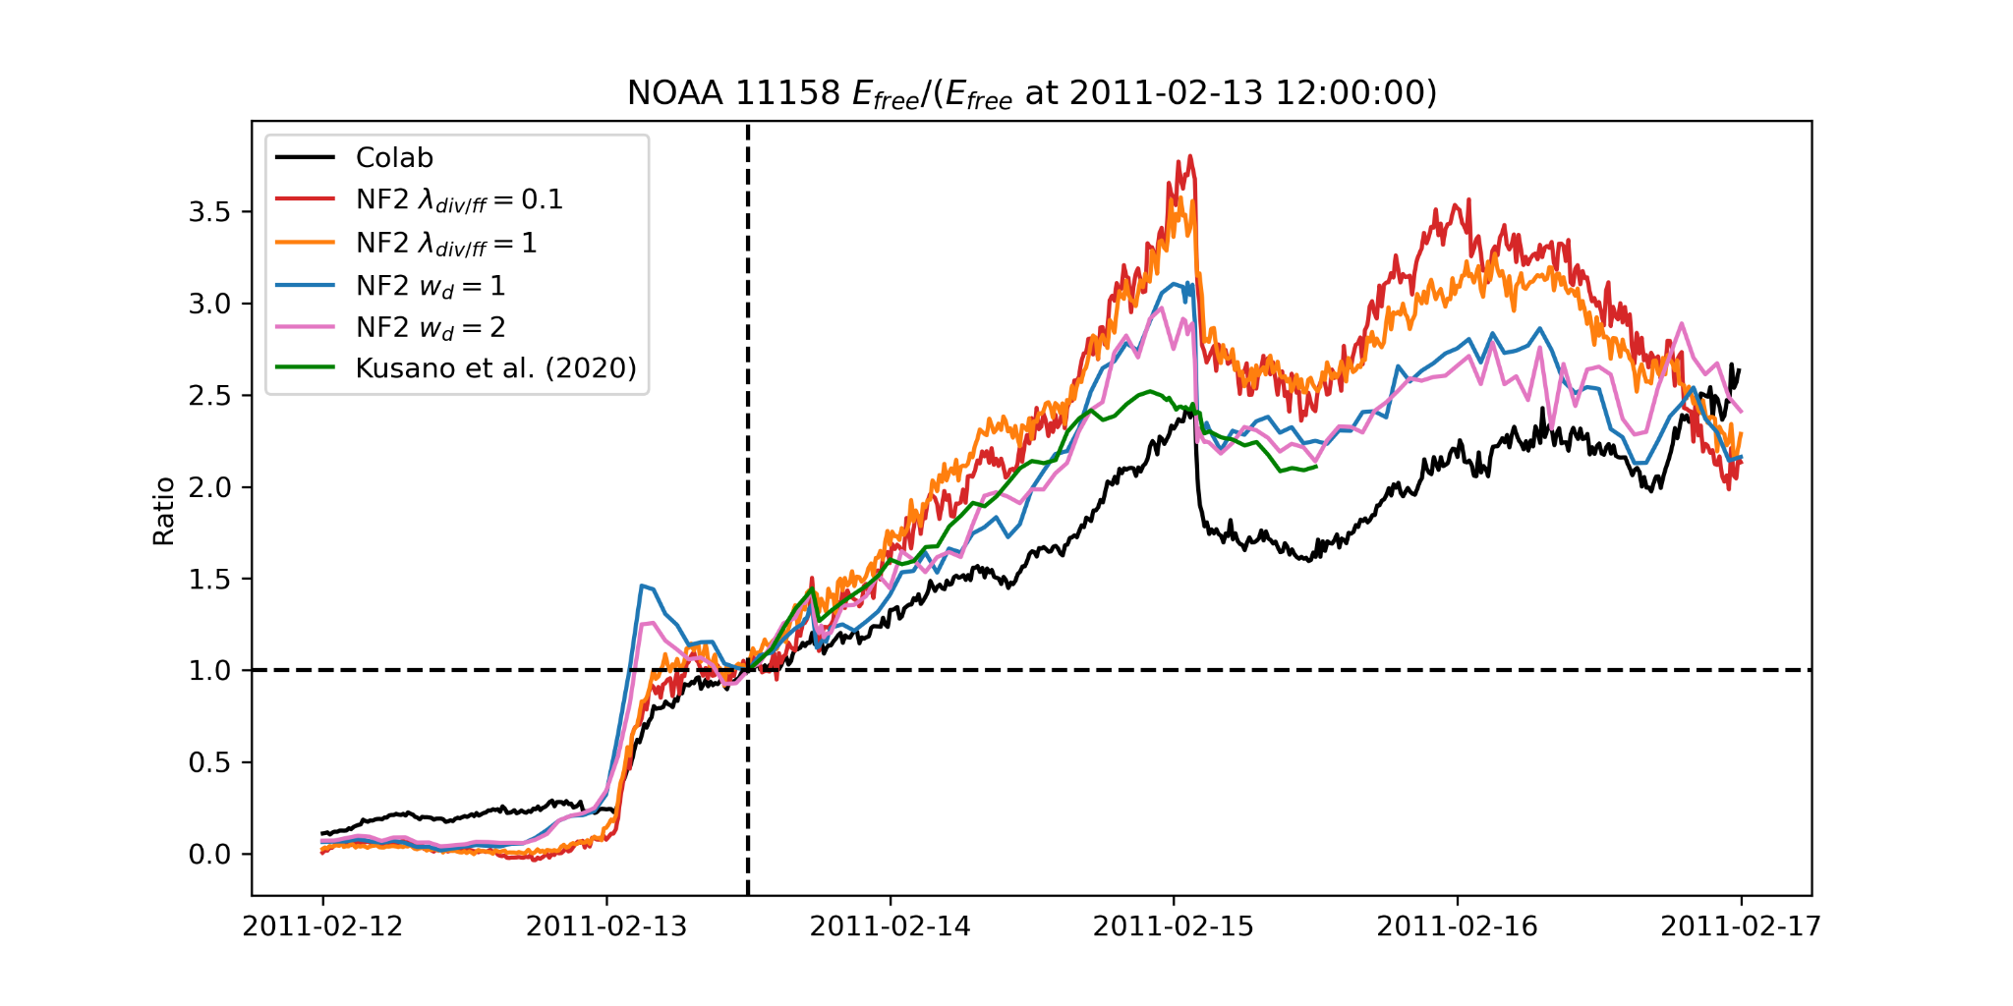
NOAA 11158

Slide 9
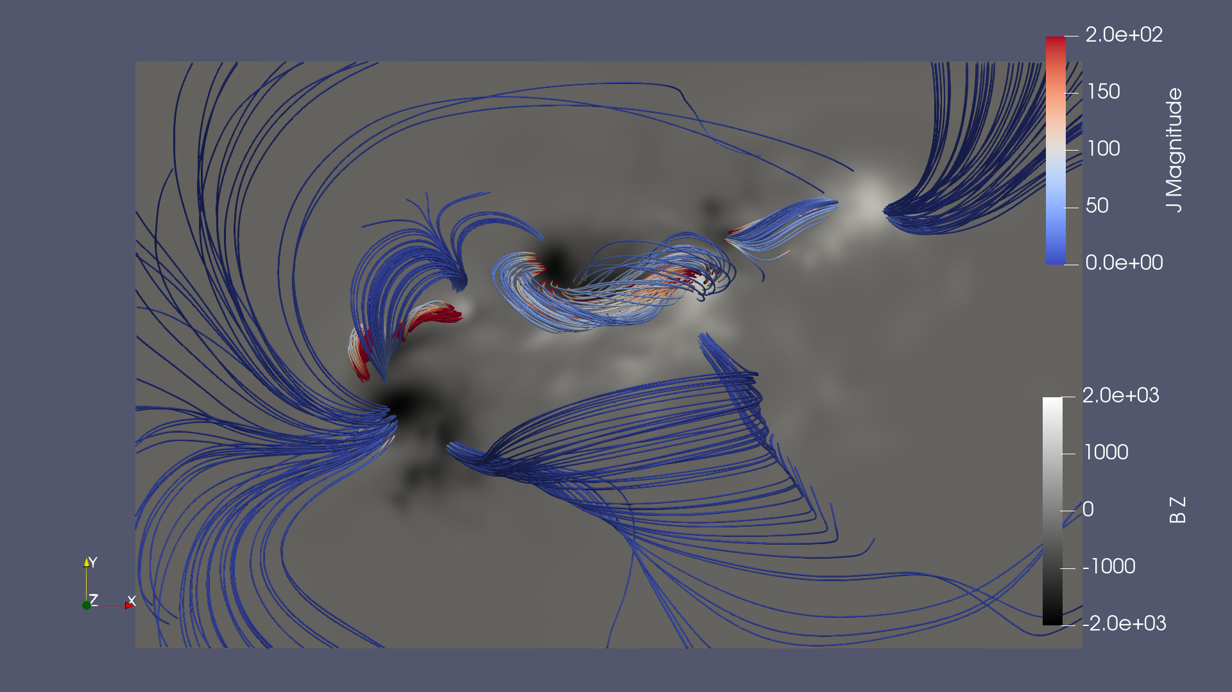
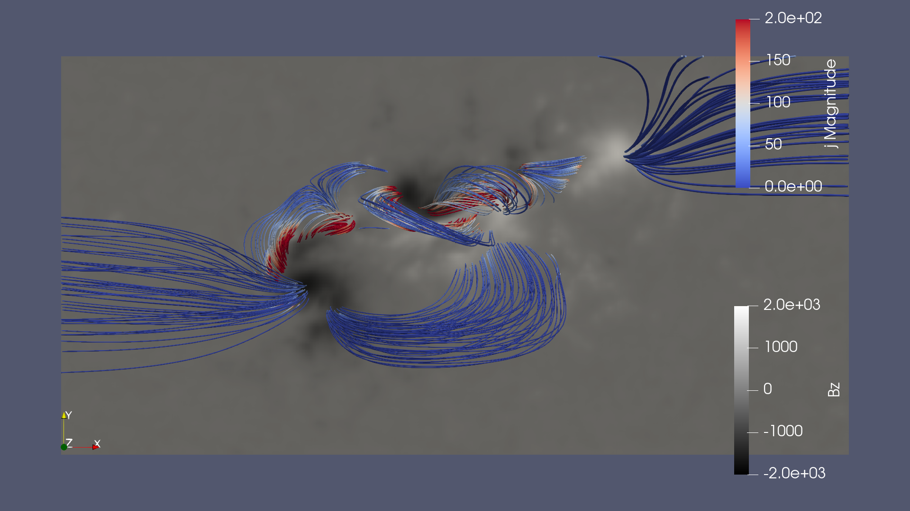

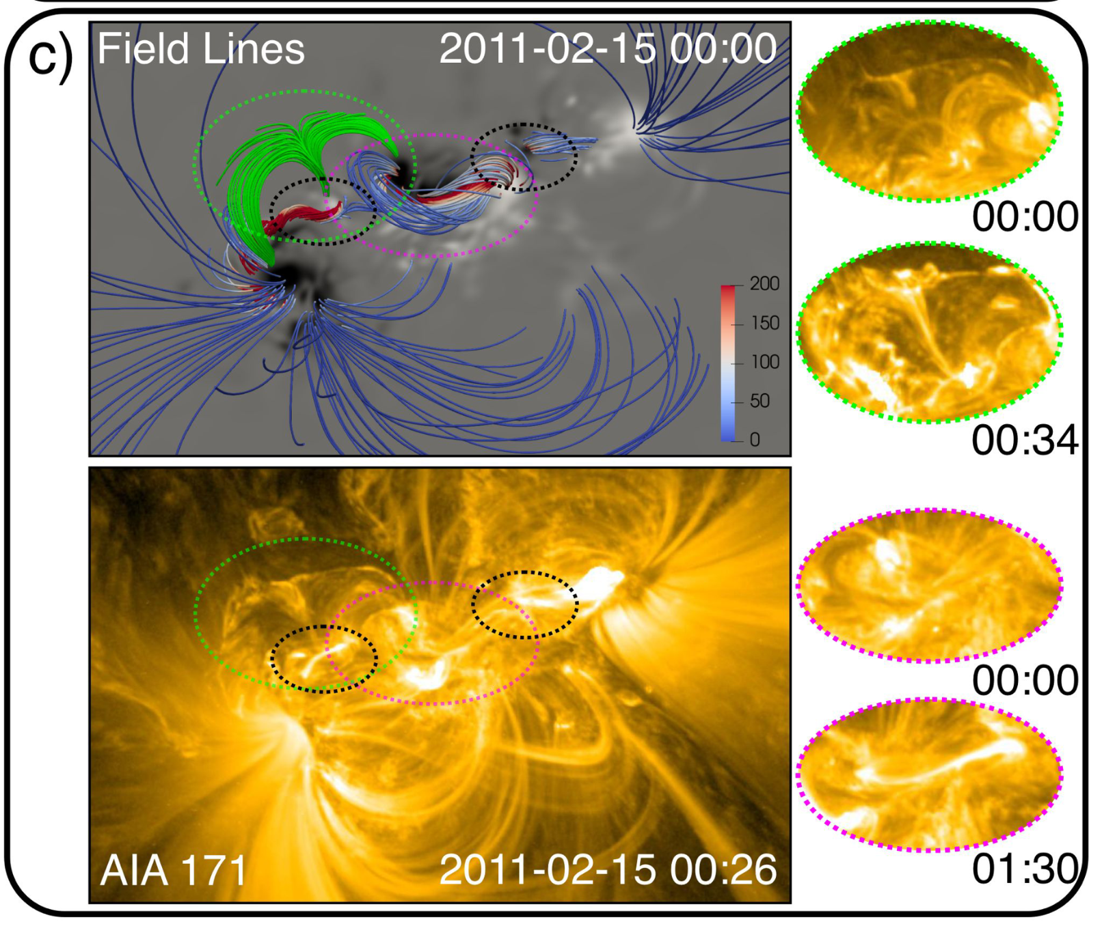
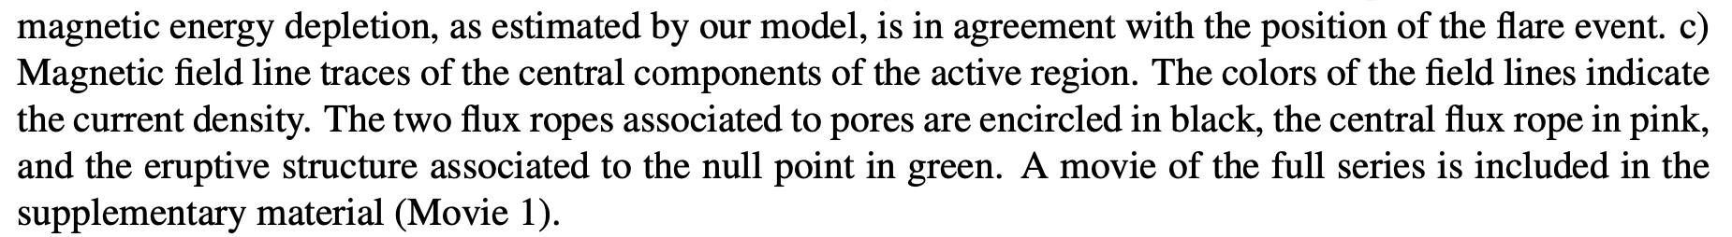
NOAA 11158
Colab
Kusano
https://www.paraview.org/

Slide 10
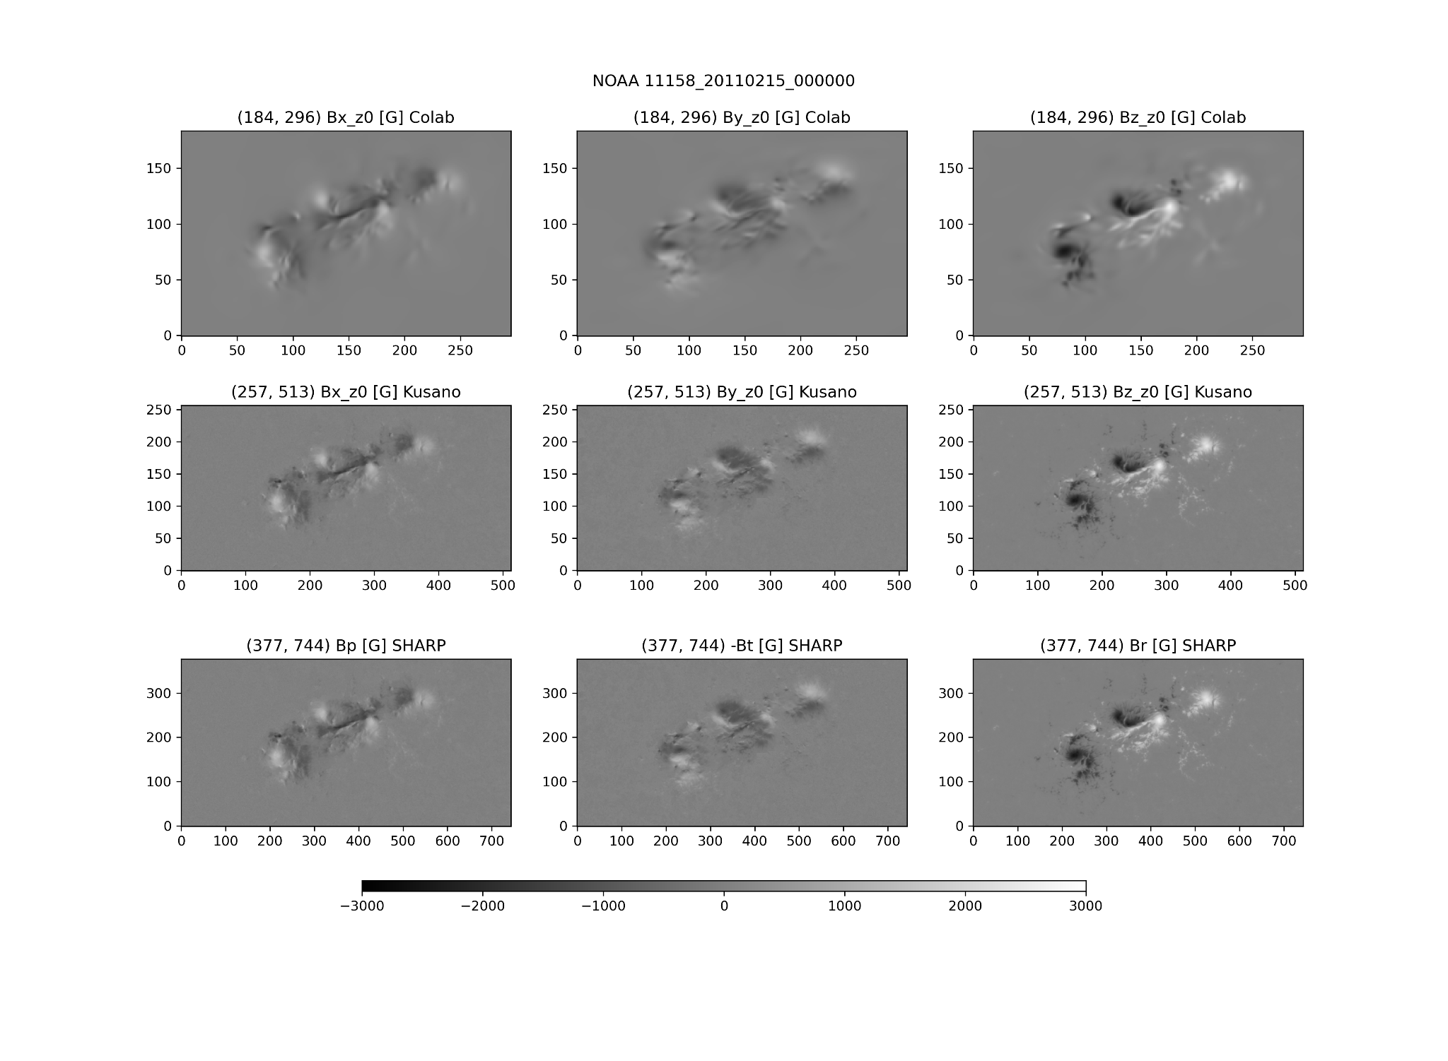
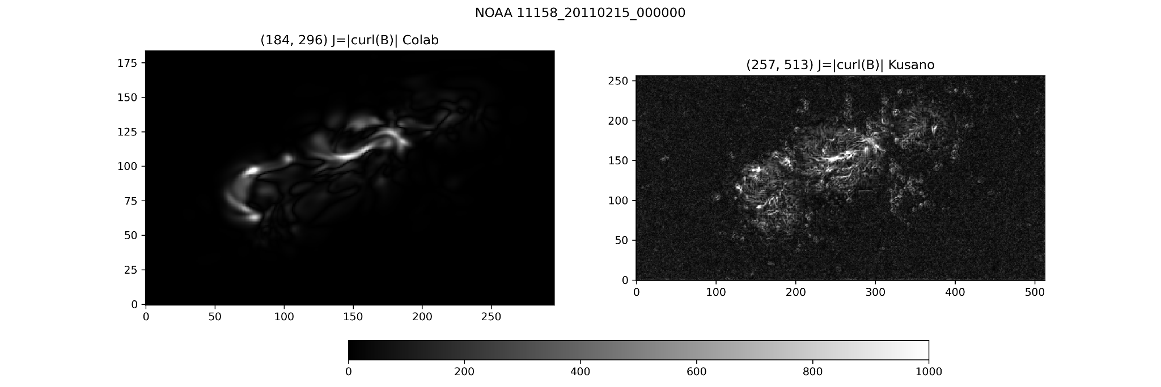
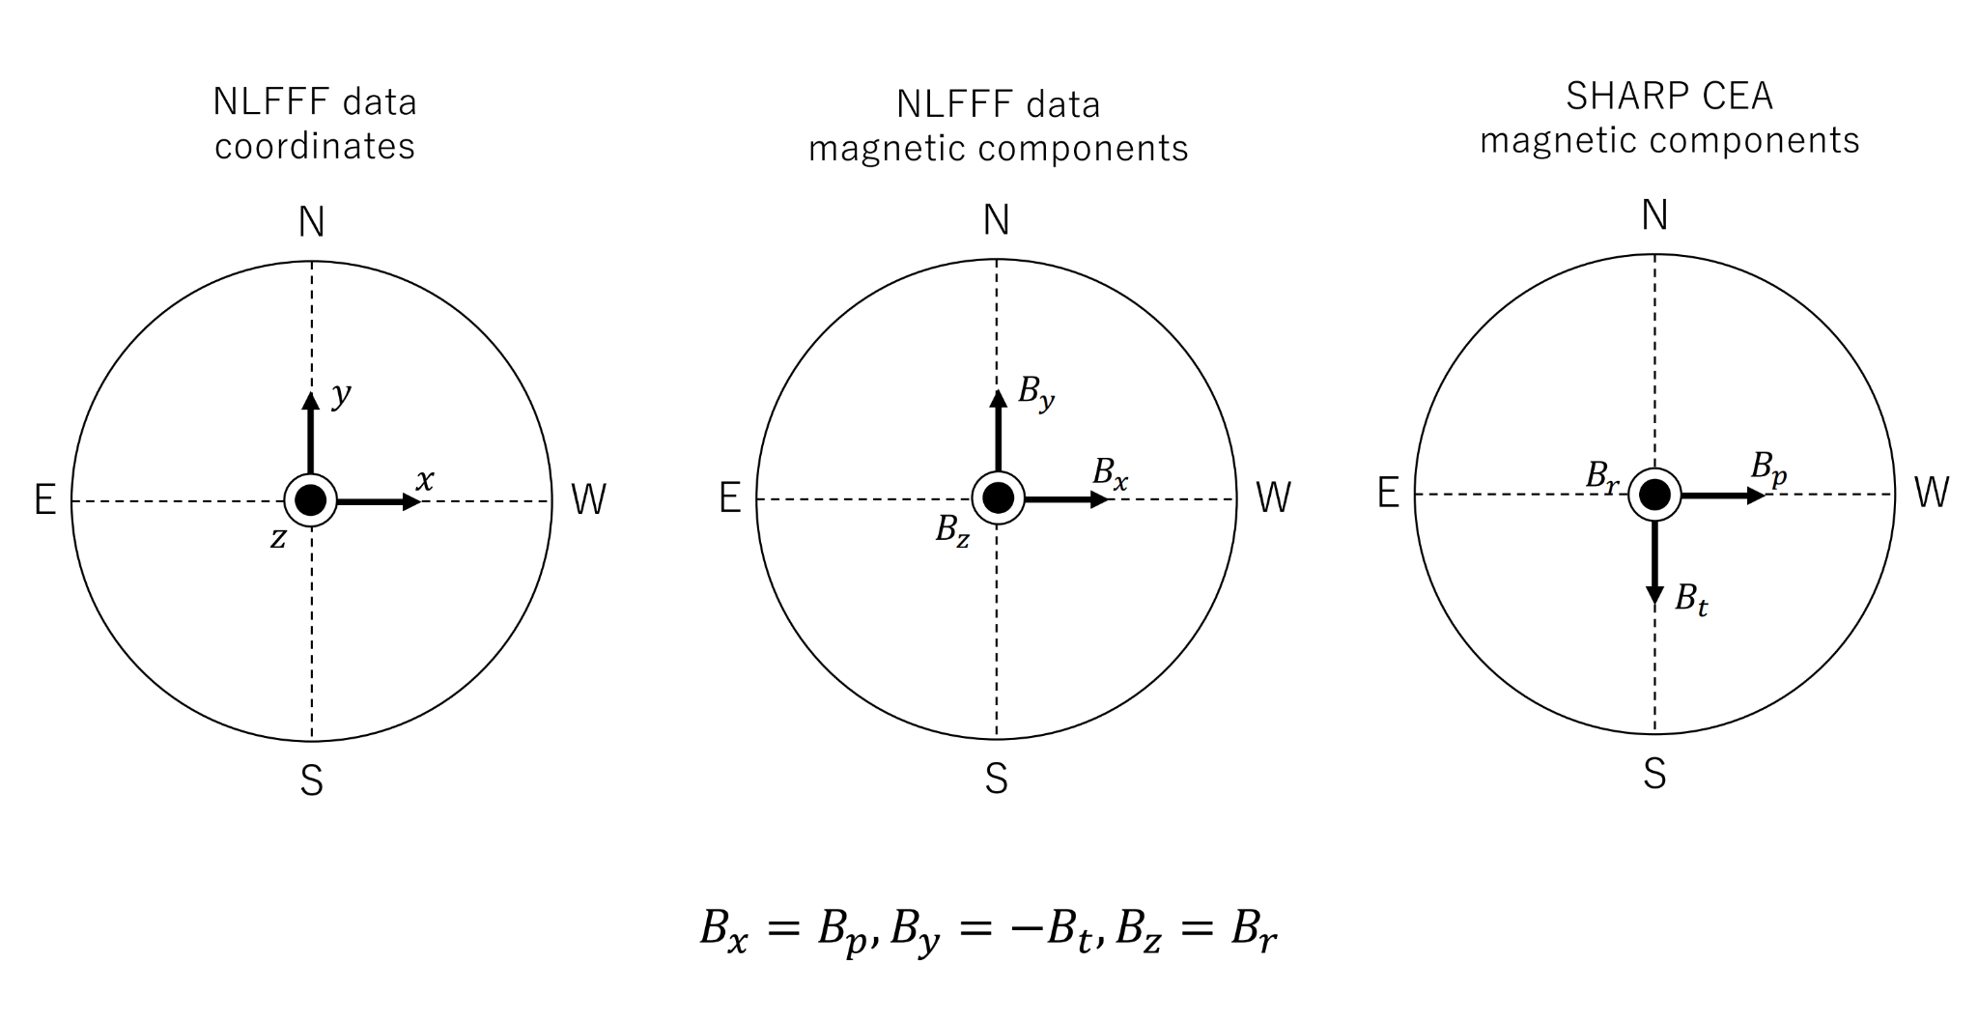
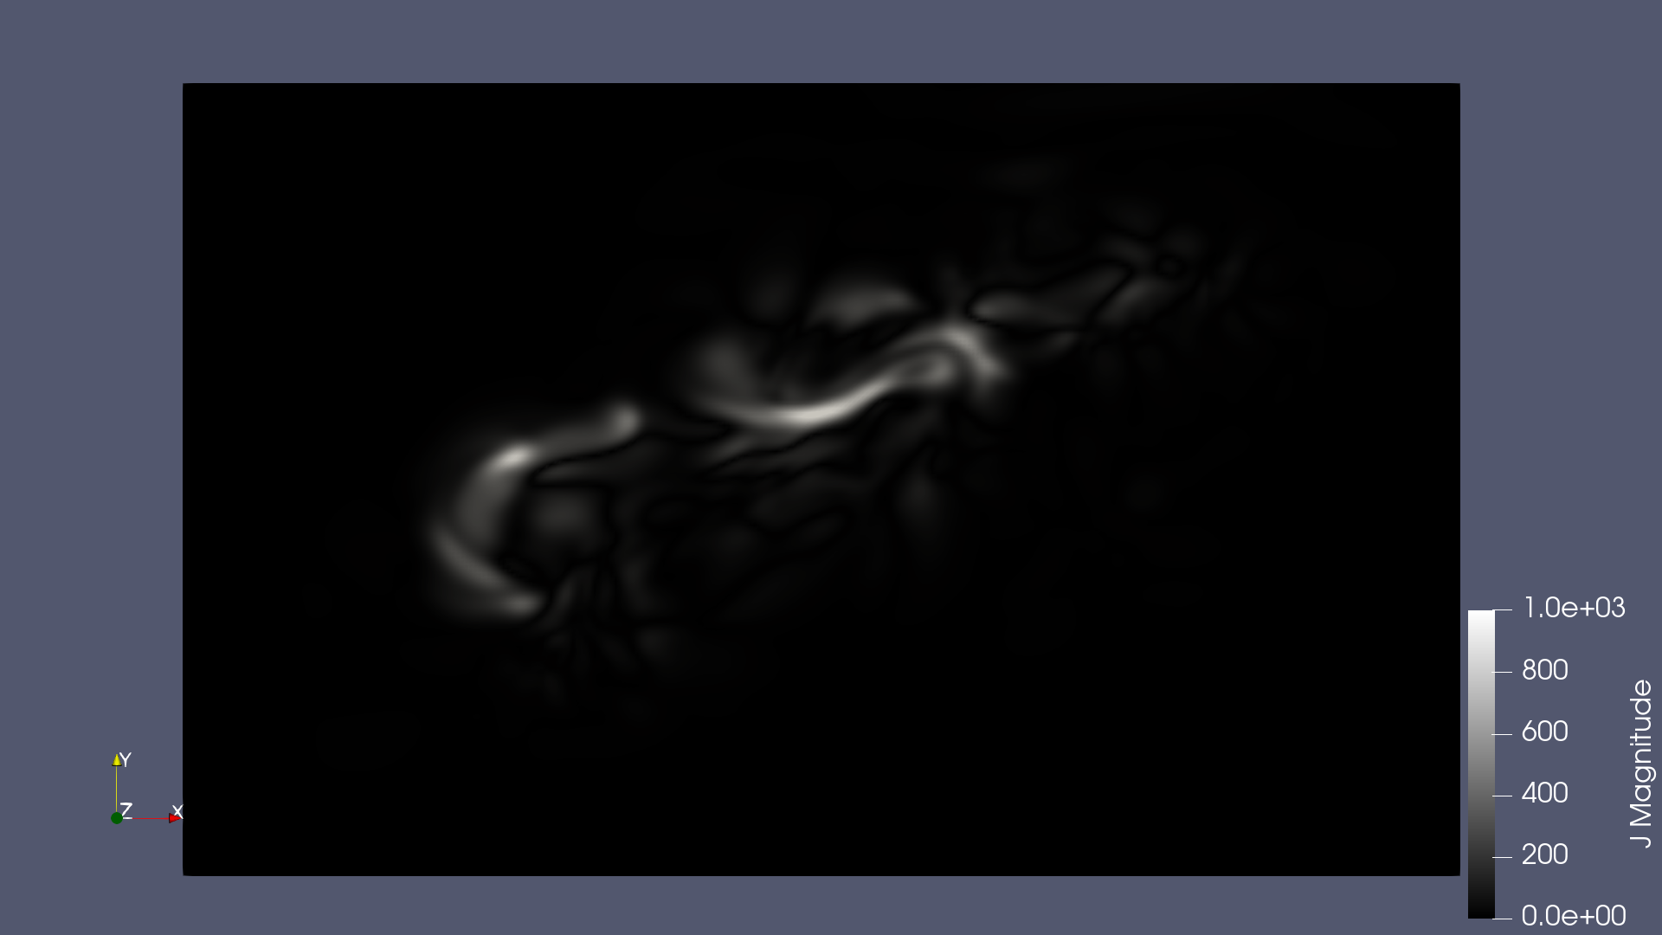
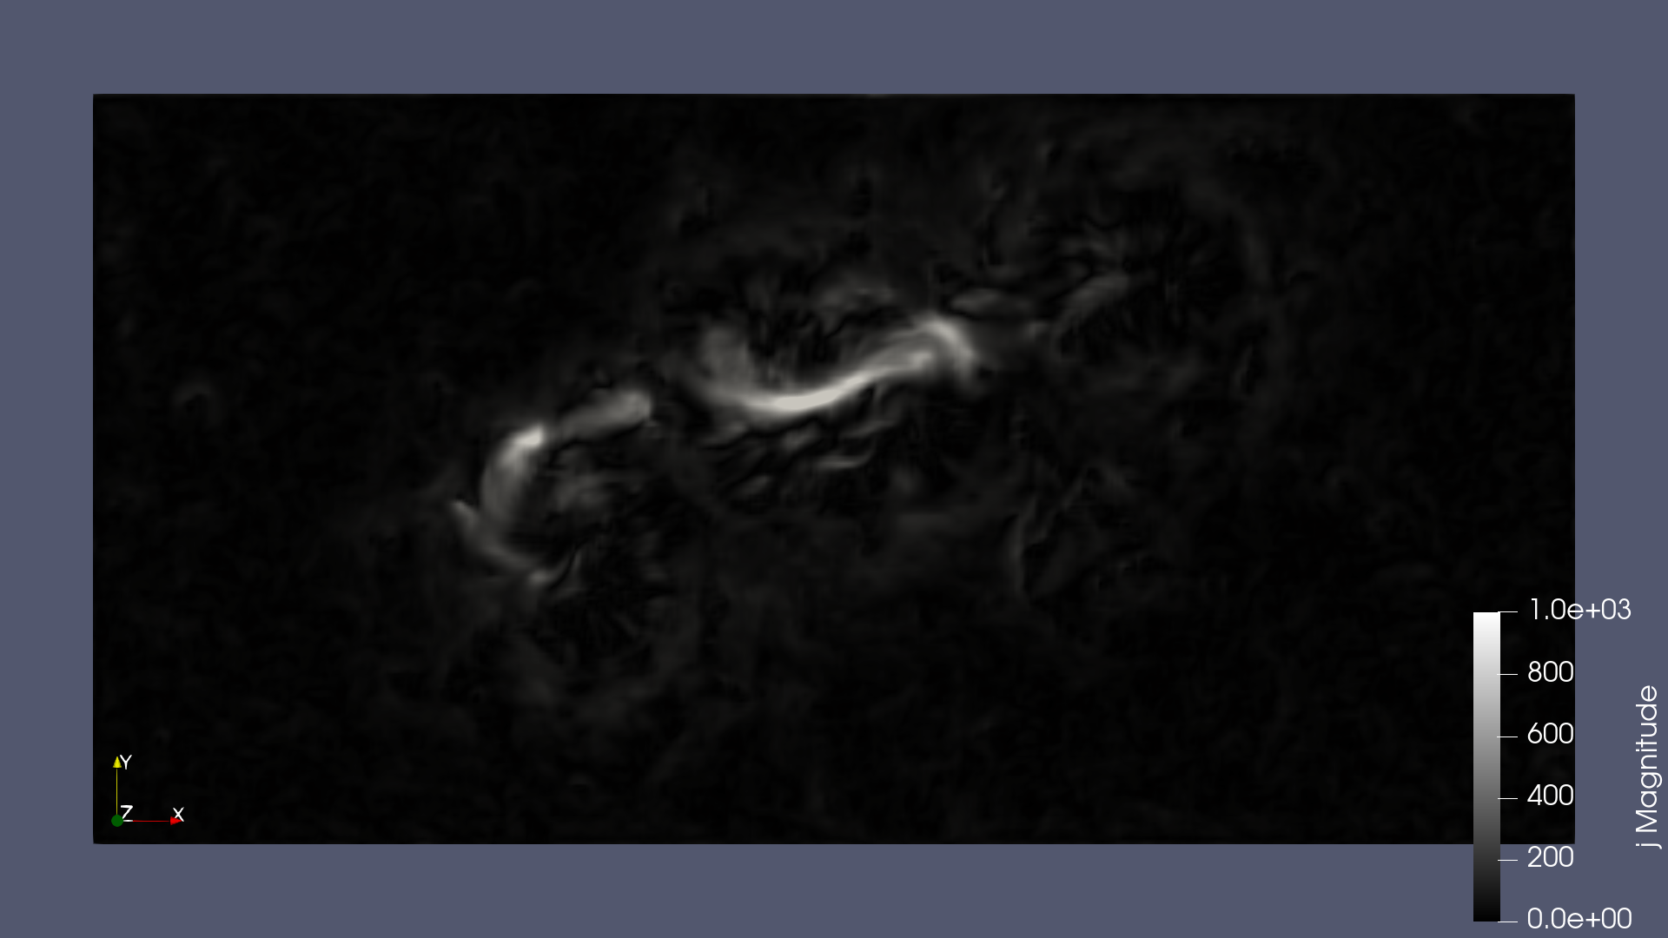
NOAA 11158
Colab
Kusano
Figure from ISEE NLFFF database homepage (https://hinode.isee.nagoya-u.ac.jp/nlfff_database/) by Kusano et al. (2020)

Slide 11
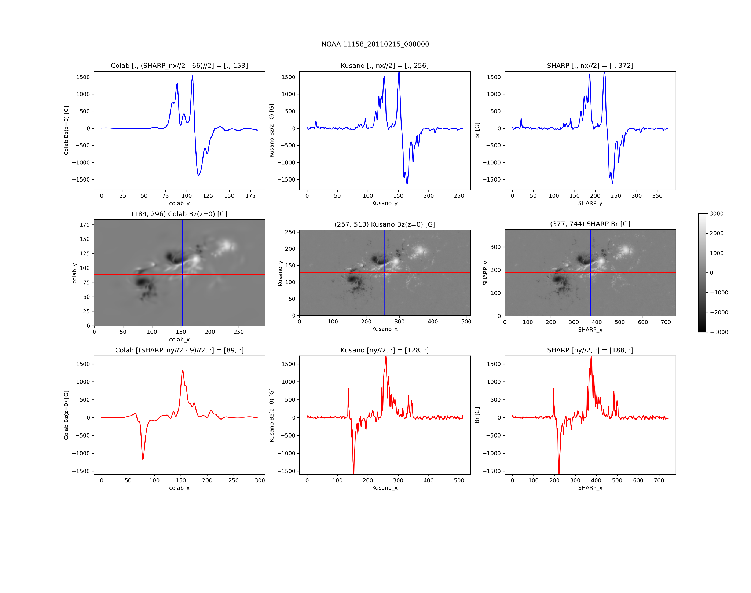
NOAA 11158

Slide 12
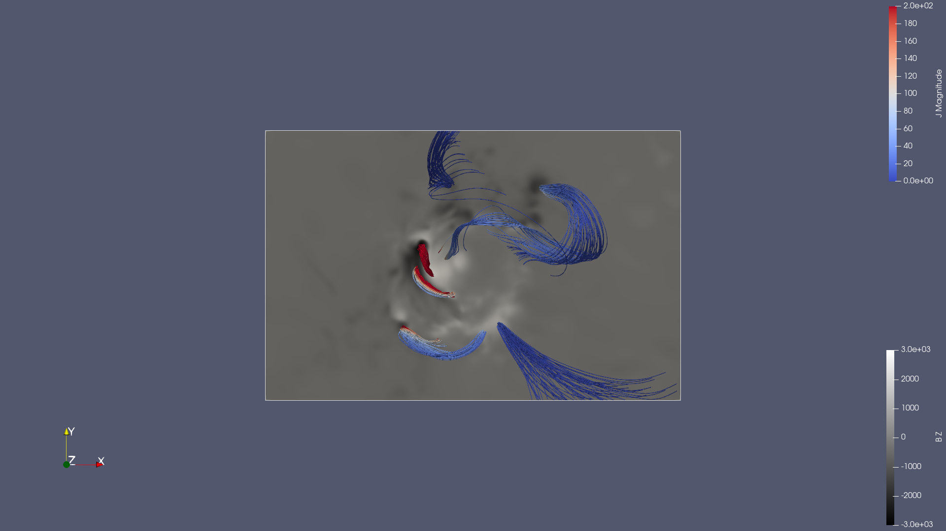
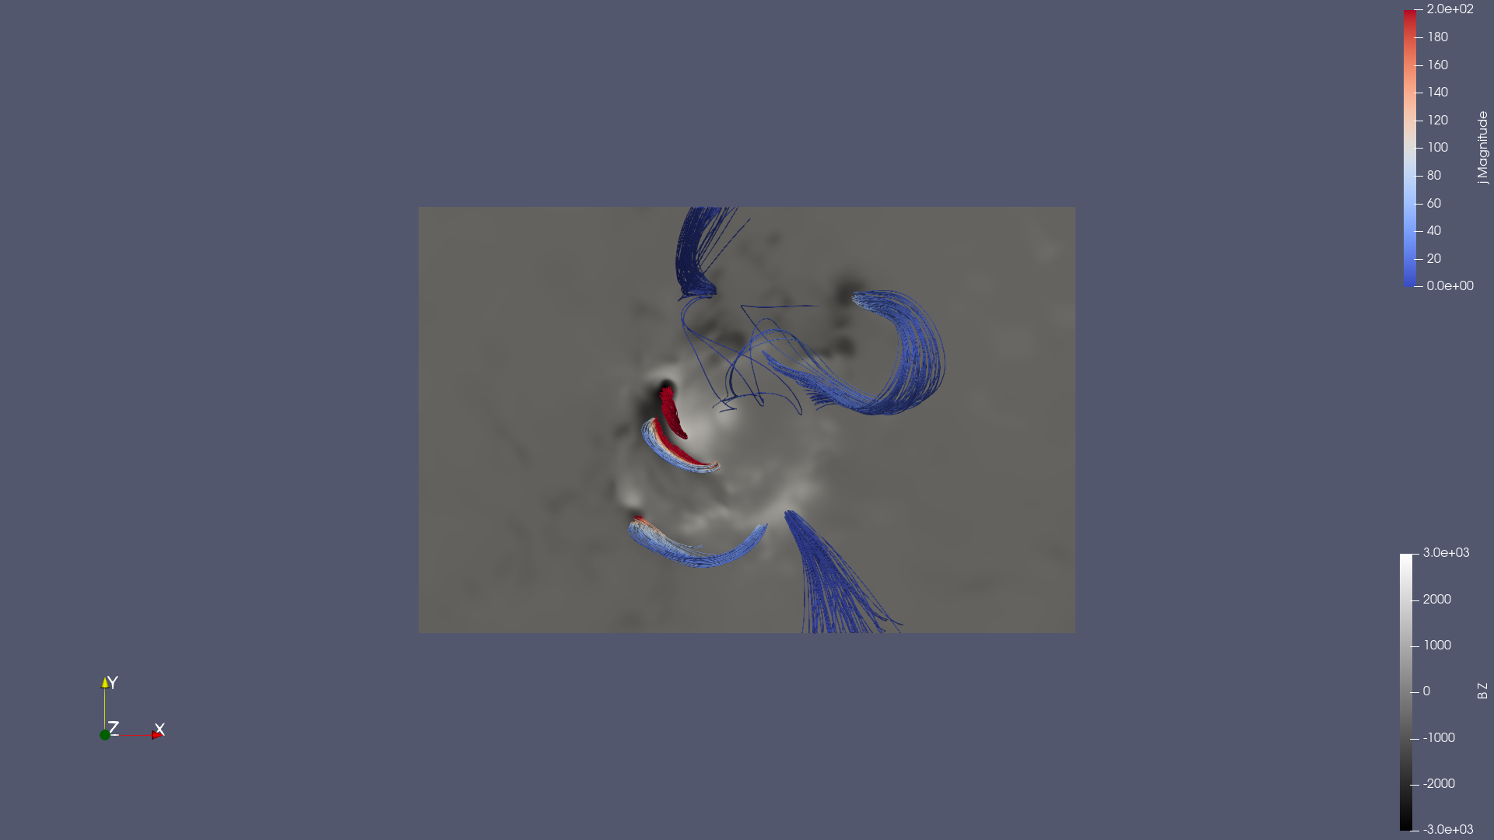
NOAA 12673
2017-09-06 08:36:00
Initial training in Colab ~ 5.5h
Data provided by authors

Slide 13
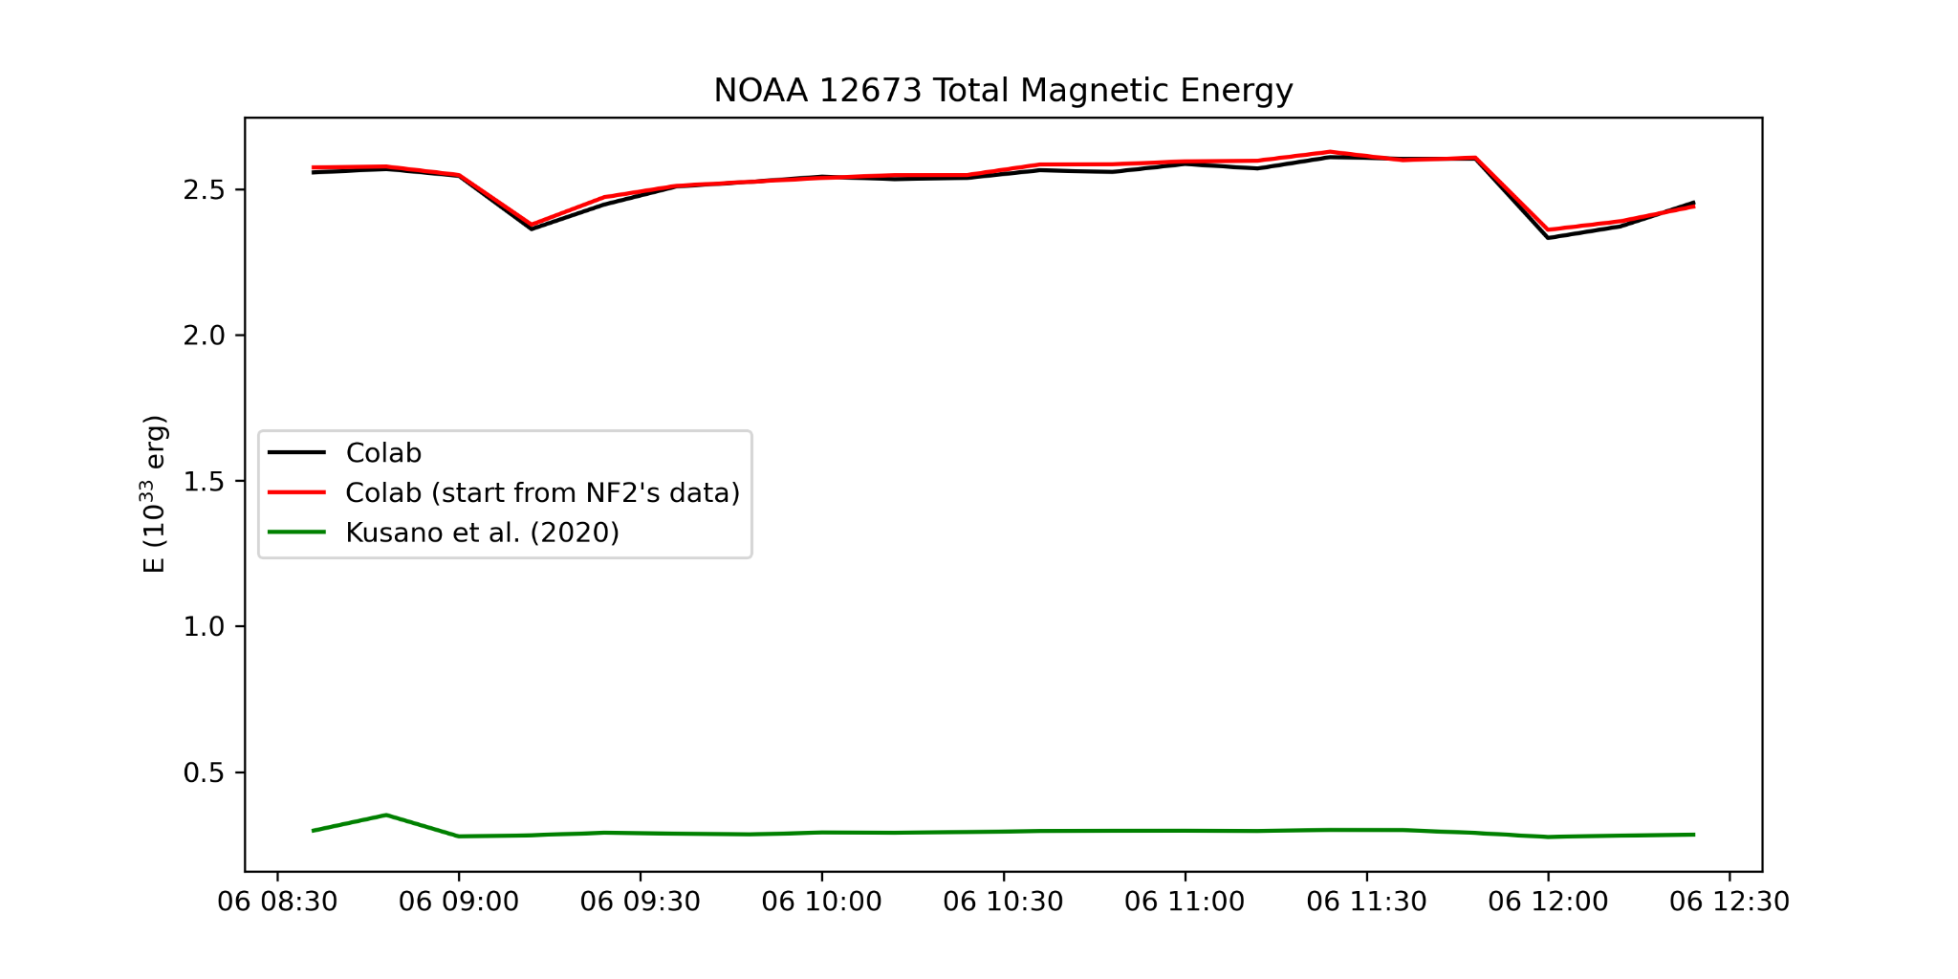
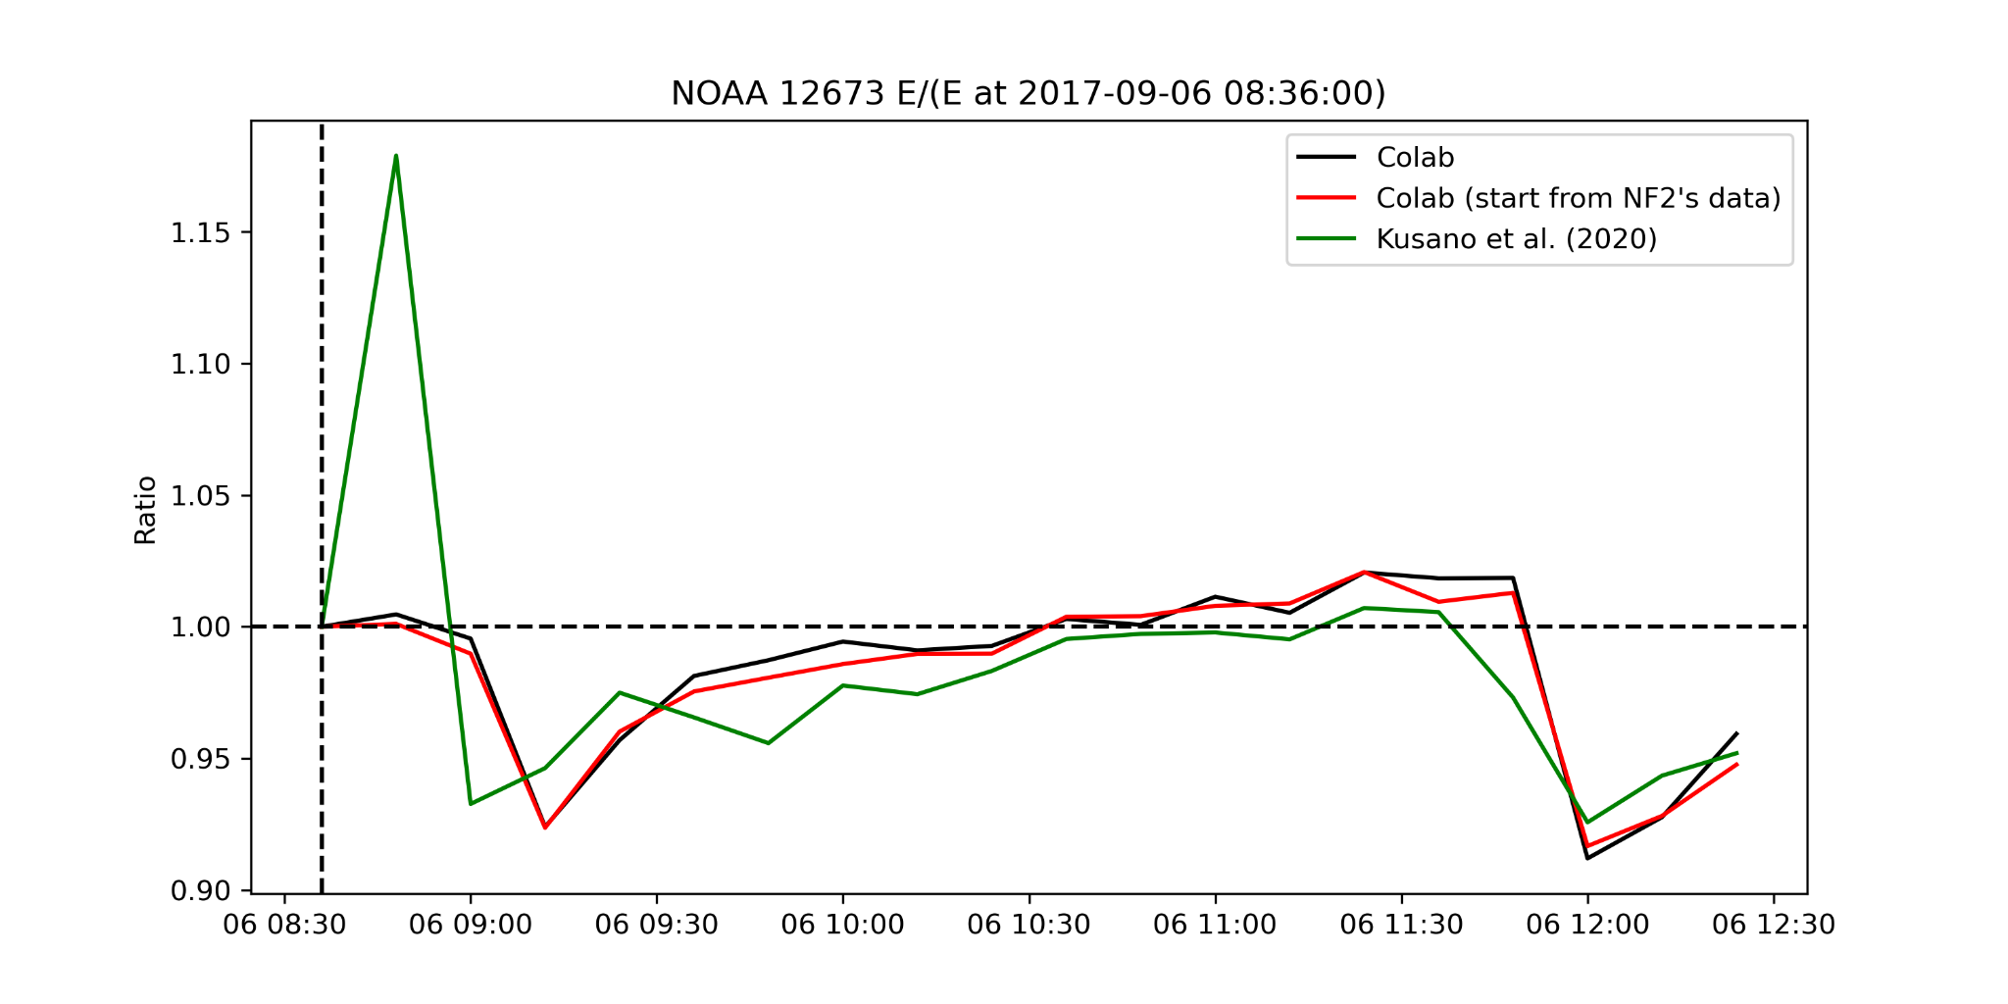
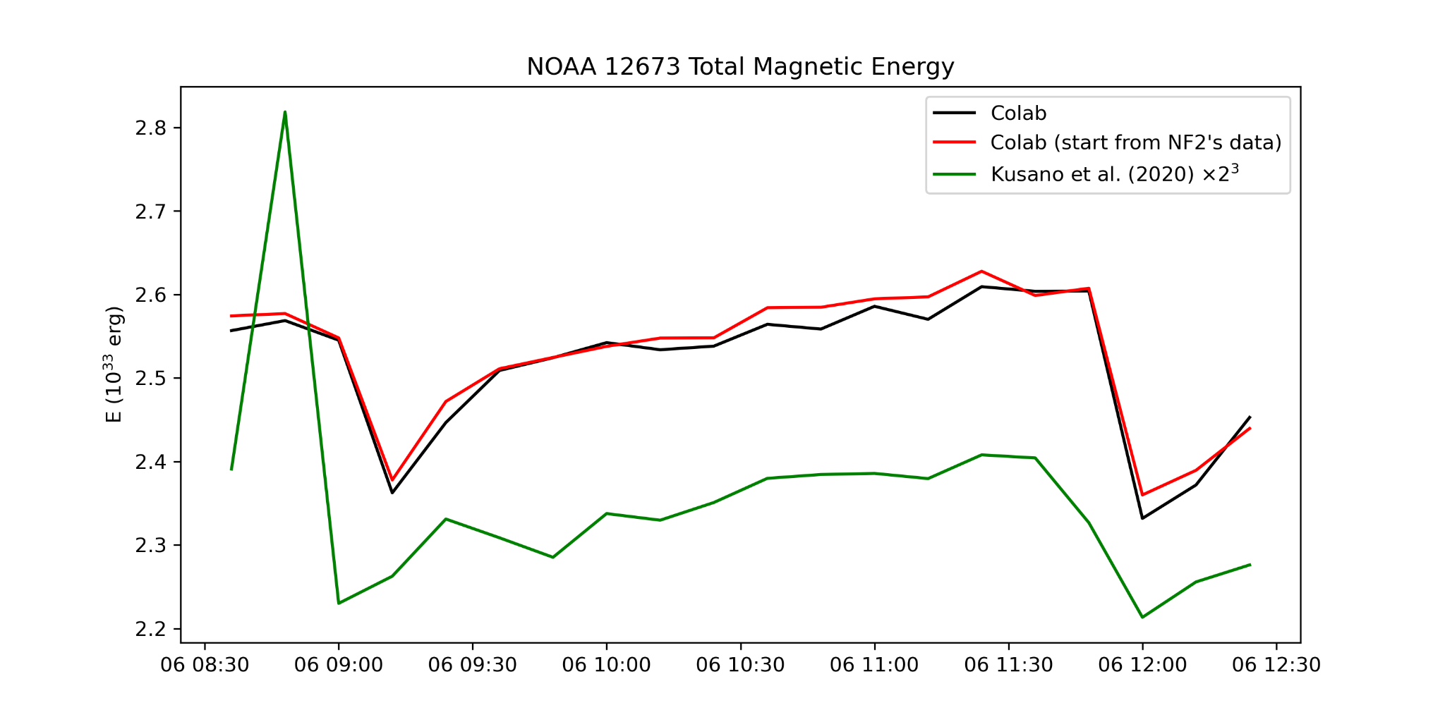
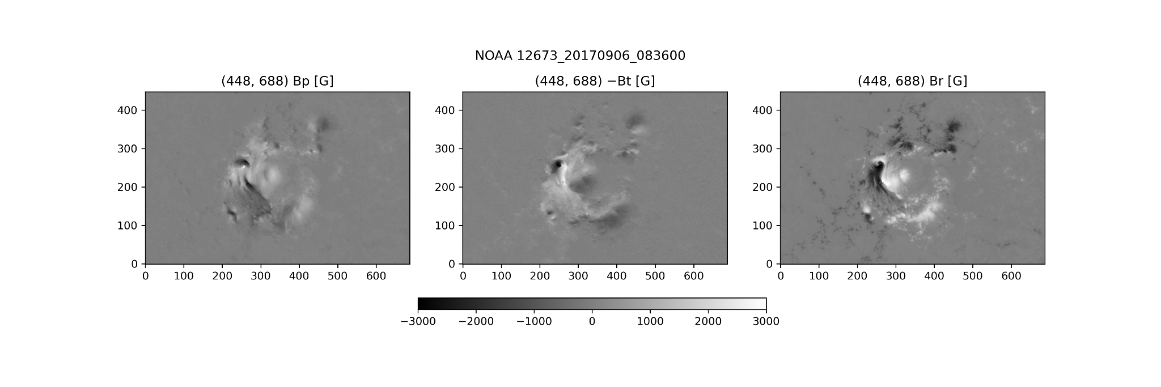
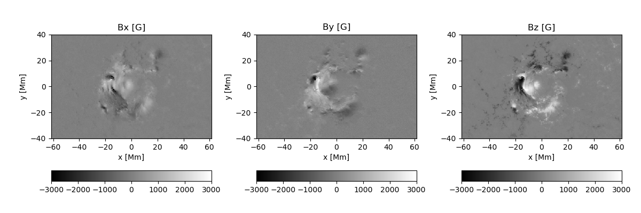
NOAA 12673
Series Training ~ 20*6.5min ~ 2.2h
SHARP Xsize = 688 pixel * 0.36 Mm/pixel ~ 248 Mm
Kusano Xsize ~ 123 Mm
SHARP Ysize = 377 pixel * 0.36 Mm/pixel ~ 161 Mm
Kusano Ysize ~ 80 Mm
=> bin ~ 2

Slide 14
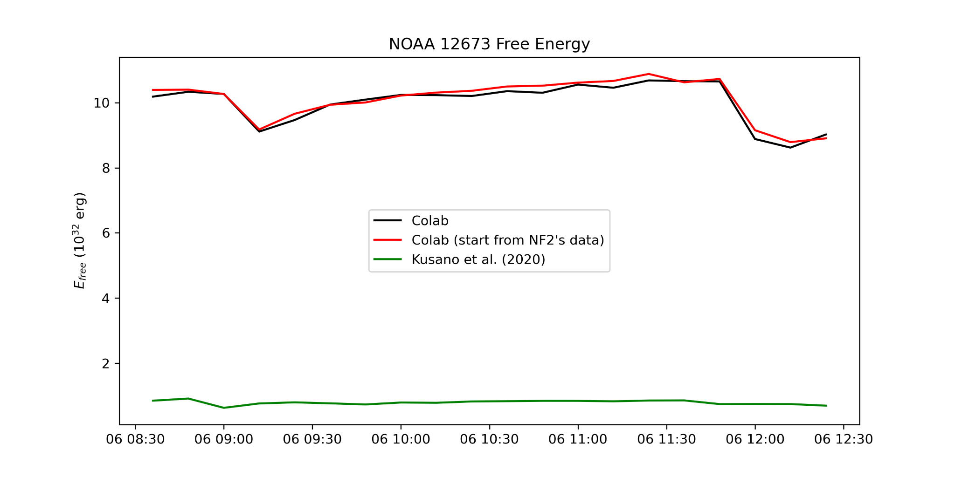
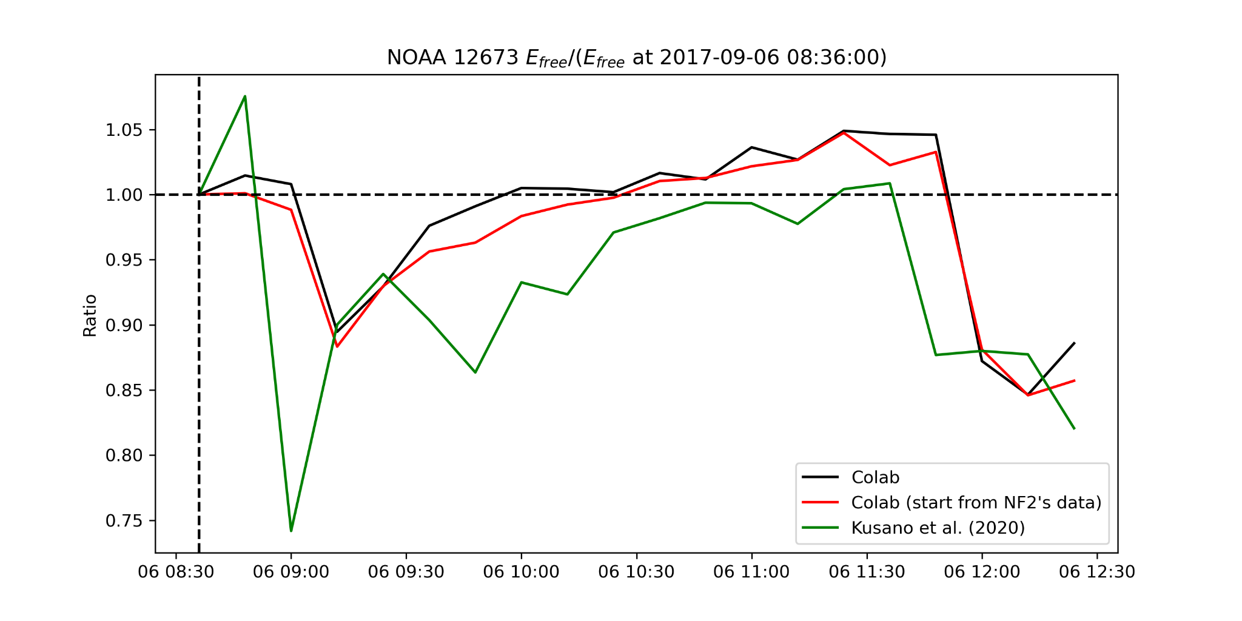
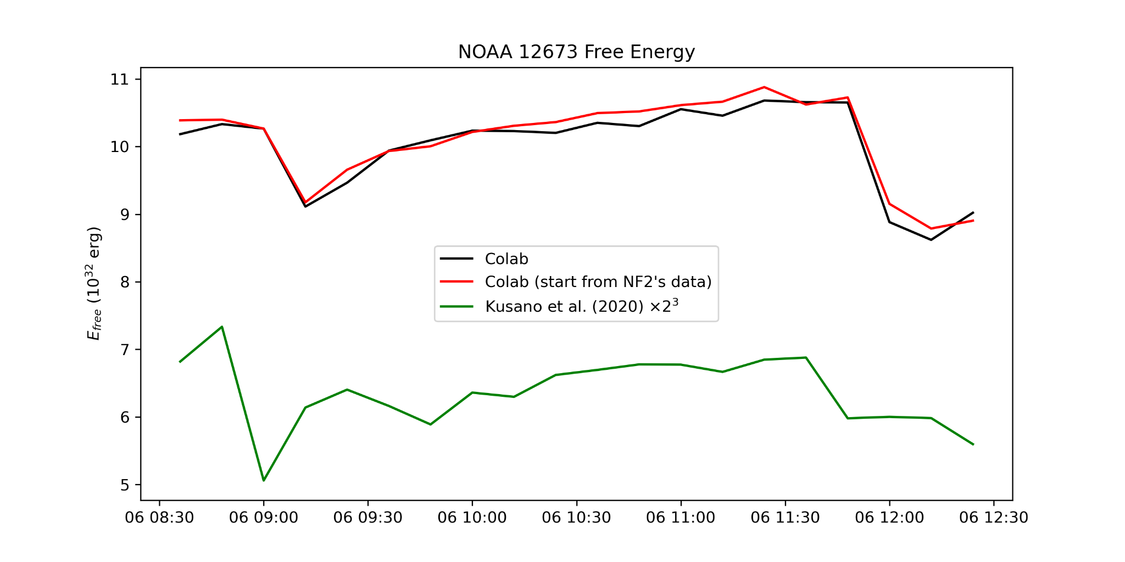
NOAA 12673
Free energy ~ 20*3.5min ~ 1.2h

Slide 15
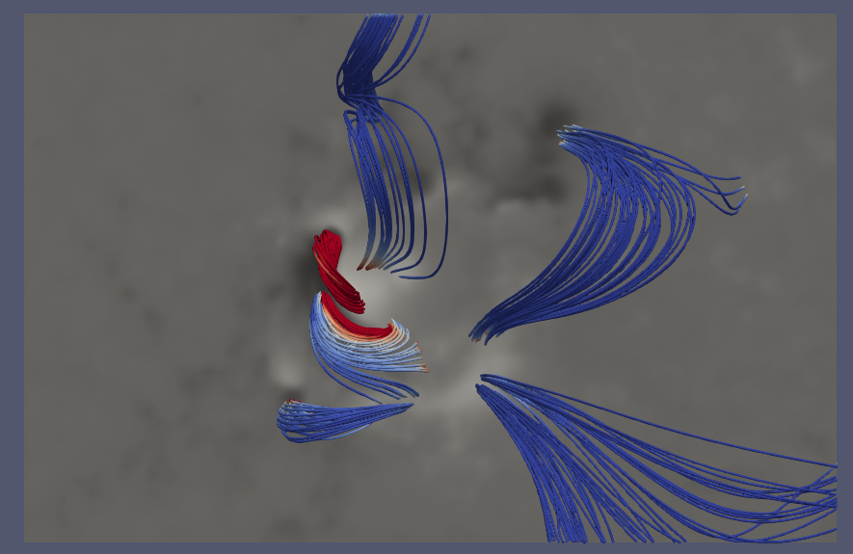
NOAA 12673
2017-09-06 08:36:00
Colab
Kusano
NF2's data

Slide 16
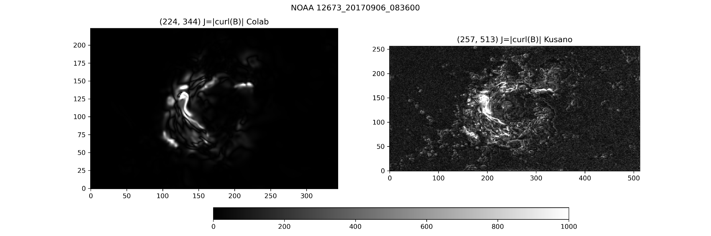

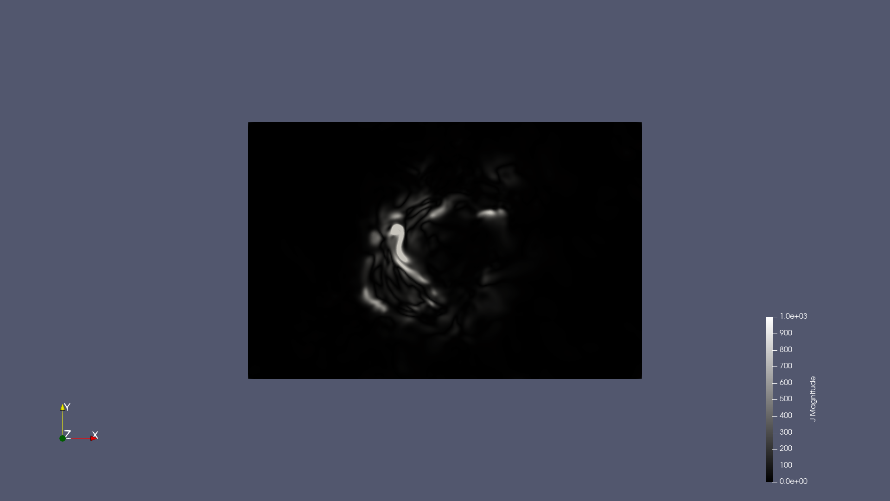
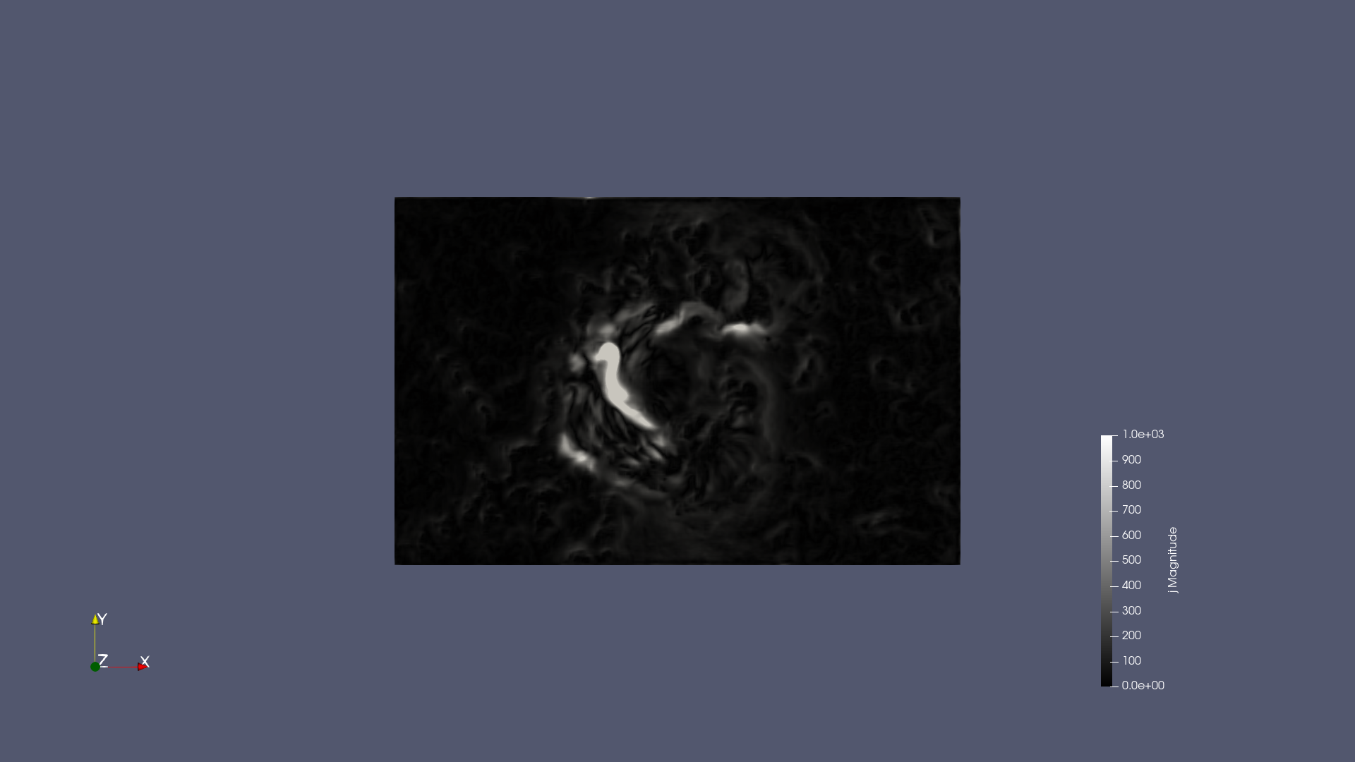
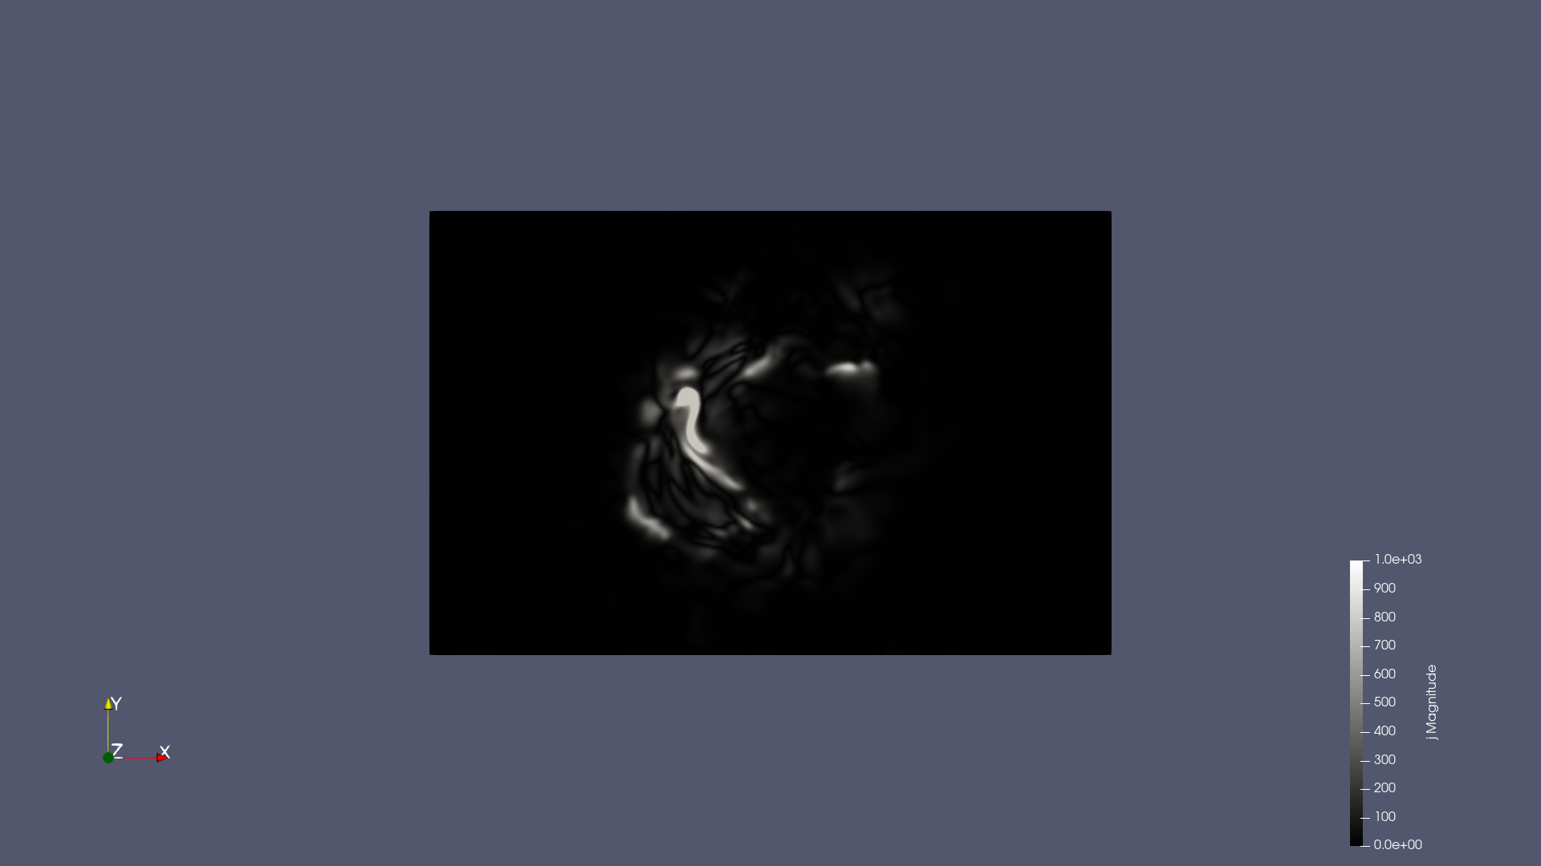
NOAA 12673
Colab
Kusano
NF2's data

Slide 17
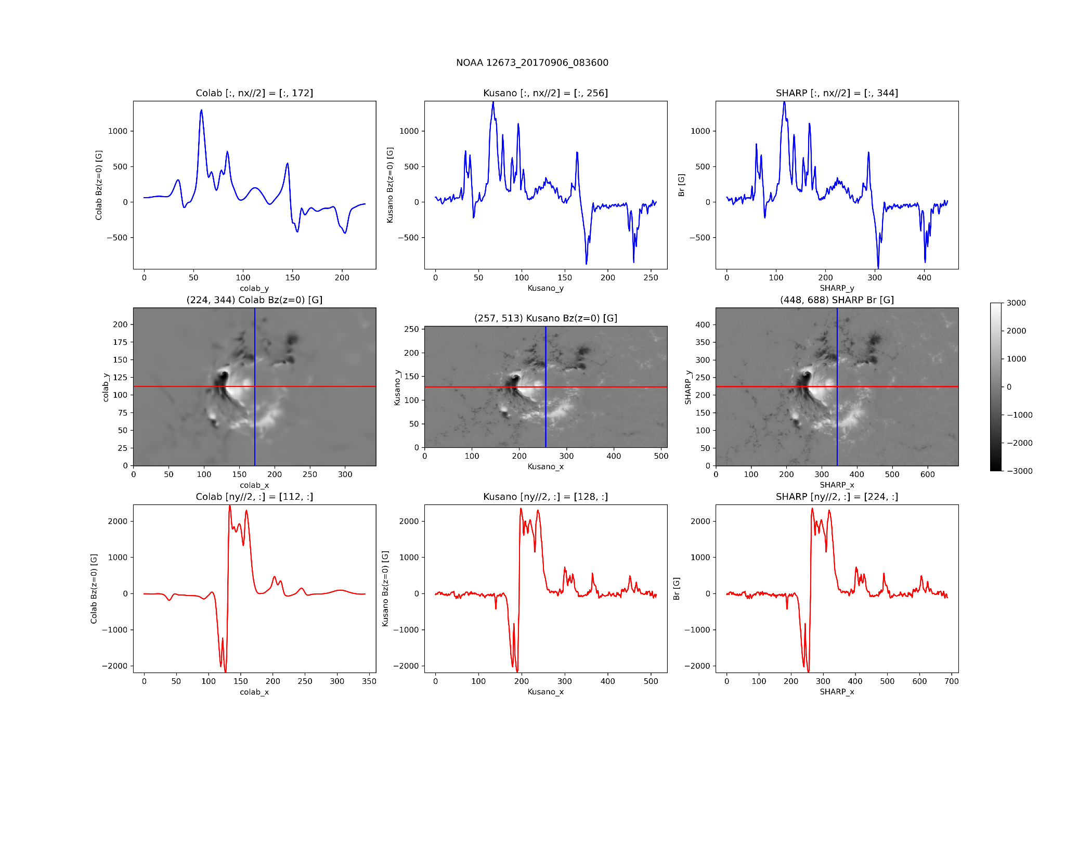
NOAA 12673

Slide 18
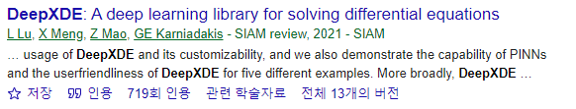
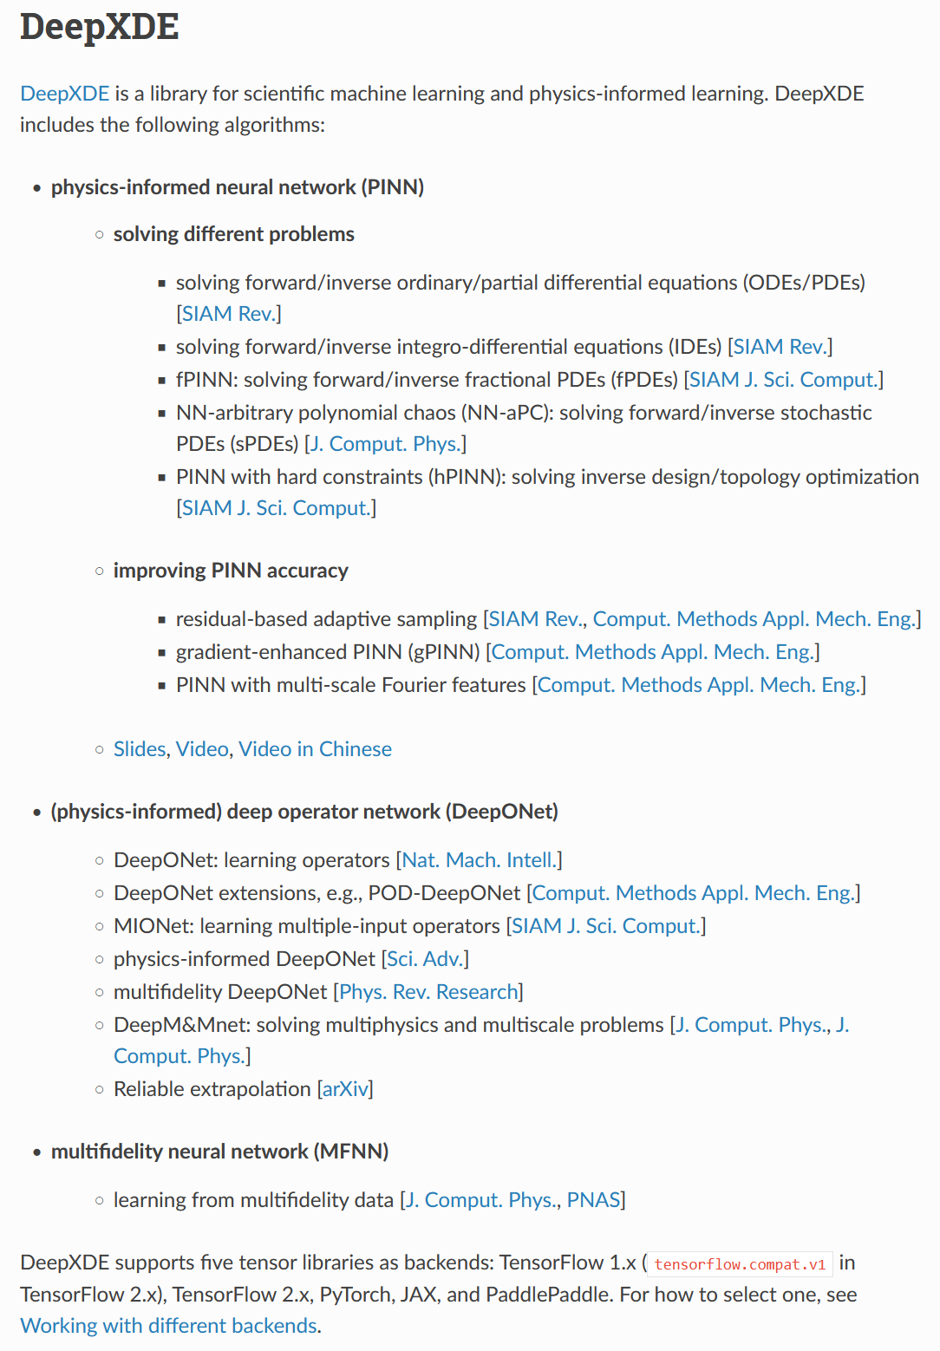
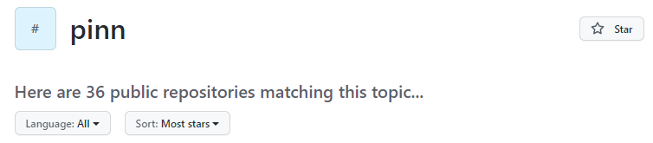

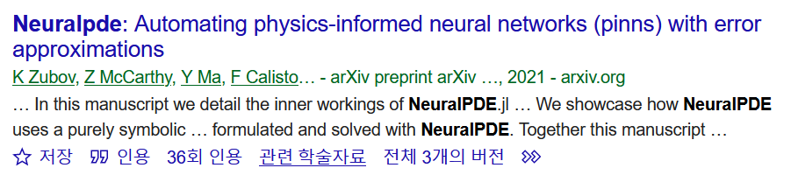


Future work - External libraries for PINN
~ 1500 stars
~ 700 stars
https://github.com/SciML/NeuralPDE.jl
https://github.com/lululxvi/deepxde

Slide 19



Future work - External libraries for PINN
https://github.com/NamGyuKang/PIXEL

Slide 20






Future work - Another loss function
https://github.com/RobertJaro/NF2/blob/main/nf2/train/trainer.py
Loss function in NF2
Loss for Boundary Condition (z=0)
?
?
https://sprg.ssl.berkeley.edu/~jimm/fff/optimization_fff.html
IDL code in SolarSoftWare (SSW) based on Wheatland et al. 2000

Slide 21






Future work - Another loss function
Iteration (not optimization)
TD (Analytical model)
NFPT (This paper, Yi et al. 2022)
VFVP (Previous code by Yi et al. 2022)
SSW (IDL code based on Wheatland et al. 2000)

